Slide 1
Tourism in Japan
Especially for foreign students
14th Dec 2018
at APU
TERAMAE Shuichi PhD
President of Human Logistics ＆ Tourism Laboratary

Slide 2
Purpose of tourism policy in Japan
The purpose of establishing Board of Tousit Industry in 1930 was the acquisition of foreign currency for the construction of battleships.
After the defeat of World War II, the purpose of Japan‘s tourism policy was acquisition of foreign currency.
In 1971 the number of Japanese travelers abroad exceeded the number of foreign visitors to Japan, the purpose of the Travel Agency Law changed to the protection of Japanese travelers from the protection of foreign travelers.

Slide 3
Convergence to the lexical "tourist"
×
National wartime mobilization (policy)
Acquisition of foreign currency (policy)
1930
Board of Tourist Industry
1938
The establishment of the Ministry of Health and Welfare
Domestic tourism concept
is undeveloped
Emphasis of lexical "recreation"
Emphasis on inbound concept
(Show the Imperial Japan)

Slide 4
Mechanisms that domestic tourism destination has occurred
Acquisition of foreign currency
OUTBOUND
Sightseeing
Etymologically speaking
INBOUND
Destination
Inauguration of the international tourism administration
1930
International tourism
(Overseas tourist propaganda)
Domestic tourism
(Facility development for foreigner)

Slide 5
However, the purpose of the Basic Tourism Law was to acquire foreign currency, and it did not change.
Together with US-dollar, Euro, etc., Yen is treated as international currency, and the necessity for acquiring foreign currency is low.
At last after the enactment of the Basic Law on Tourism Nation in 2007, its aim changed to secure National pride.
Compared with the economic scale of the country, it was a recognition that the number of customers who visited Japan was small.

Slide 7
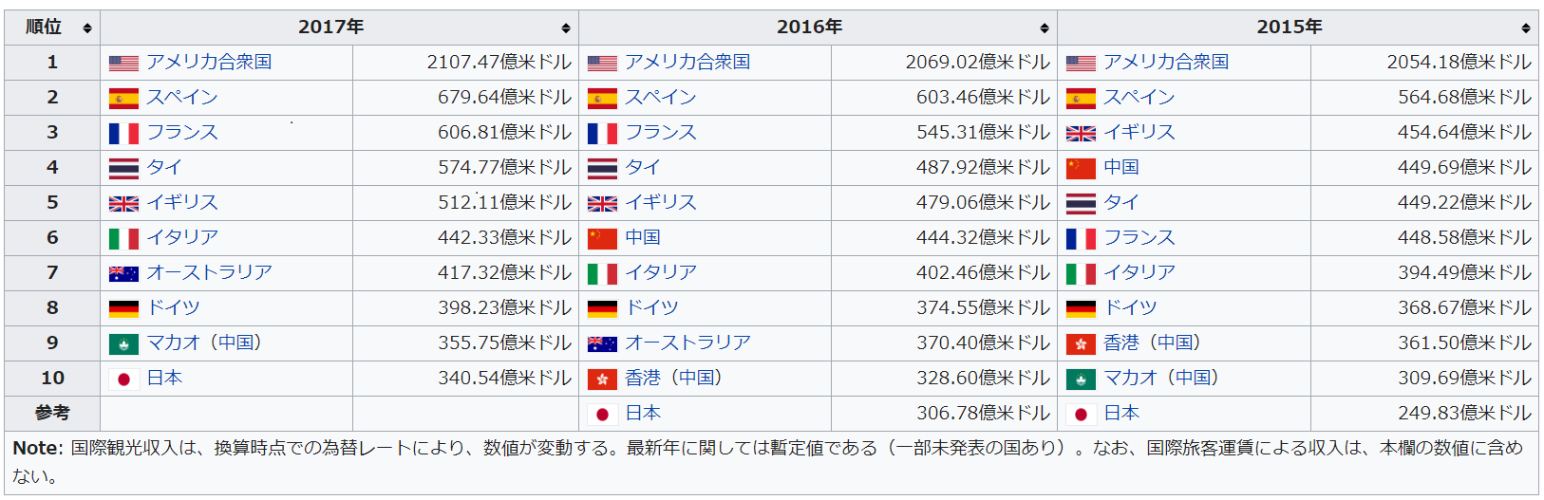
International Tourism Revenue

Slide 8
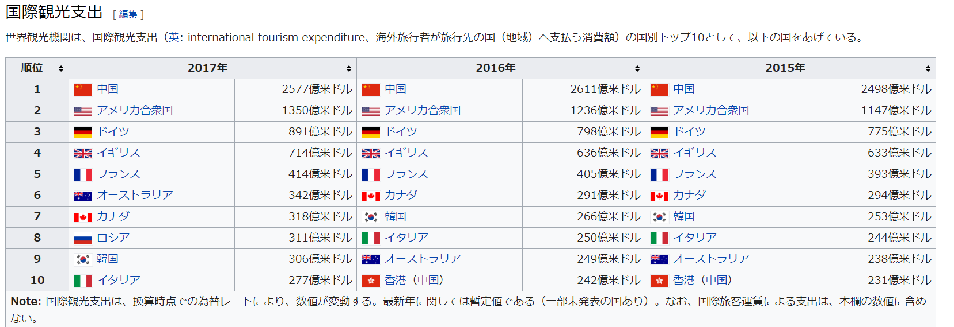
International Tourism Expenditure

Slide 9
Is the surplus of the international tourism income meaningful?
The trade balance of the United States has a large deficit. However, the capital account is a large surplus (China, Japan etc purchase US federal bonds etc).
In other words, China manufactures goods and sells it to the United States. China purchases US government bonds and travels abroad using the earnings dollar.
In the international market, if the dollar gets excessive in a country, the exchange rate of that country will soar and the foreign currency assessment held by that country will go down.

Slide 10
The situation in Japan
Japan is no longer a major manufacturing country.
In Japan's international revenue, interest income and intellectual property rights income of foreign currency held are large, and tourism revenue ratio is not large.
However, as the population declines, Japanese countryside expects income from foreign tourists. Therefore, politically, the increase in the number of visitors to Japan is meaningful.
Factors of the increase in foreign tourists visiting Japan are, first of all, improvement of income of the Far East. Secondly, due to the appearance of LCC etc., the cost reduction of air fares and the effect of depreciation of the yen are the effects.
Politically, Japanese want to explain that evaluation of Japanese culture has been done properly.

Slide 11
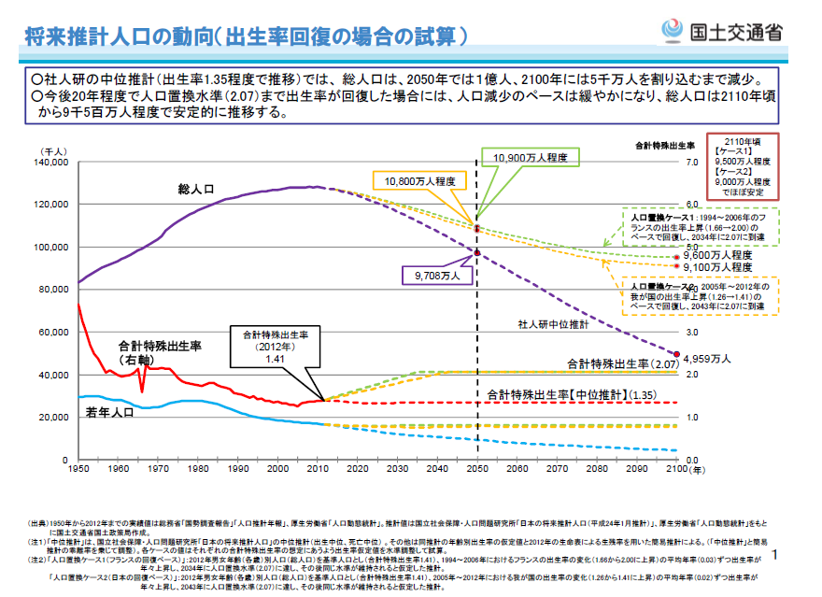

Slide 12
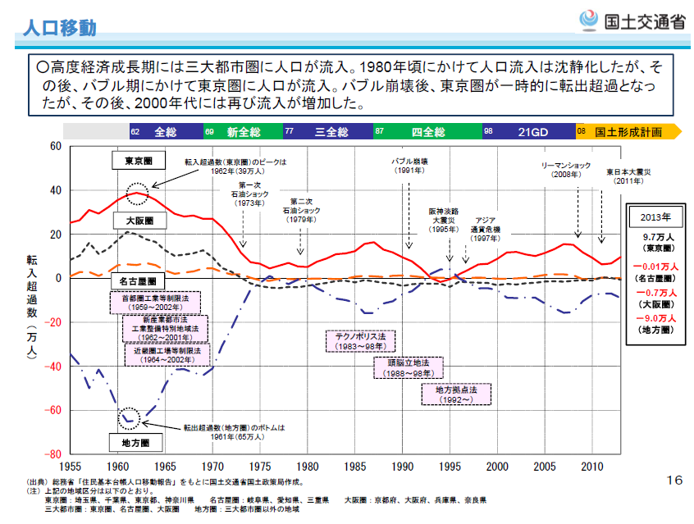
Tokyo's economy can not grow without foreign workers
Red line:Number of people flowing into Tokyo
There is no longer a population flowing from the country into Tokyo.
Blue line: Country population decreased

Slide 13
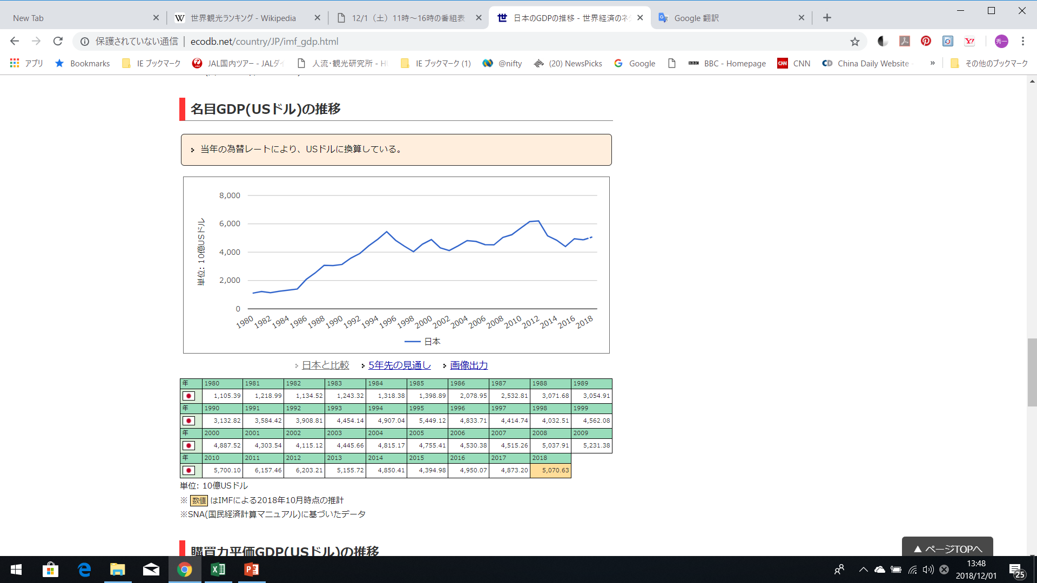

Slide 15
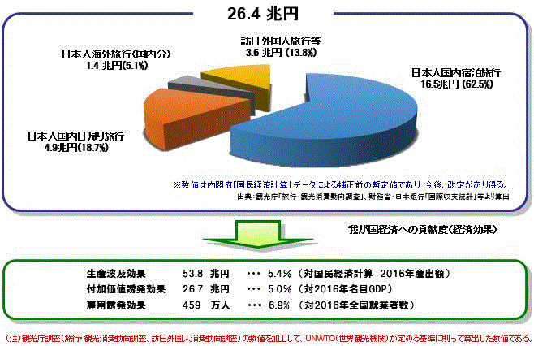
Economic ripple effect of the tourism activity
26.4
trillion yen
48.8
trillion yen

Slide 16
関係する企業、組織
航空会社 日本企業 JAL、ANA
外国企業
鉄道会社 JRグループ、東京、大阪の私鉄
ホテル 日本企業 帝国ホテル、ホテル大倉
ホテル 外国企業
旅行業
日本の中小企業（旅館、タクシー・バス会社等）は後継者不足 買収して経営者になる機会はある 資金源の確保

Slide 17
Tourism resources system
～ What mind and regulations produce ～

Slide 20
Western-style “Hotel” and
Japanese-style “RYOKAN”
Do you take off shoes?

Slide 21
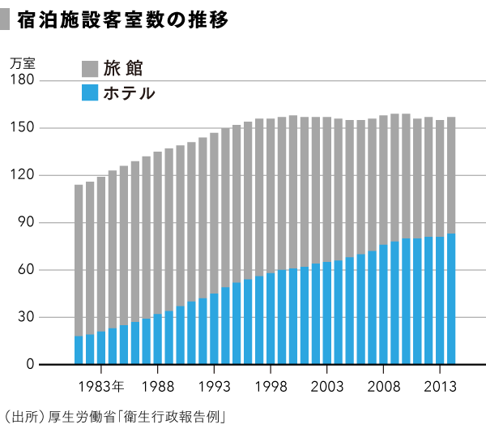
HOTEL（ｂｌｕｅ） and ＲＹＯＫＡＮ（graｙ）
Ten of thousand

Slide 22
Japan accommodation can be classified into four
Registration
Dilution of policy significance
Registered Hotel
Registered Ryokan
Non-registered Hotel
Non-registered Ryokan
Non-Registration
Obfuscation
Hotel
Ryokan

Slide 23
For western people
Westernization
Relativization
Popularization
Clear differences in lifestyle
(at that time)
For Japanese
people

Slide 24
Law of Renting Private Homes and Rooms
With opportunity to enforce Law of Renting Private Homes and Rooms, according to the Accommodation Business Law, the division of legally separating Hotel and Ryokan was abolished.
However, the legal difference between real estate rental contracts and accommodation contracts is still unclear.

Slide 25
Abolition of tourism interpreter business law
As long as you have the ability, anyone can implement tourism interpreting business.

Slide 26
Launch of a system for land operators
In order to arrange for travel services in Japan, at the request of a foreign travel agency, qualified persons must be placed.

Slide 27


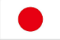
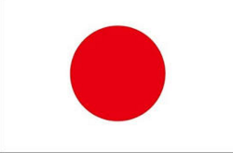
Big Differences in thinking on public transport
Ｂｅｔｗｅｅｎ ＵＫ ａｎｄ Ｊａｐａｎ
ＰＵＢＬＩＣ ＰＲＩＶＡＴＥ
Private Hired Vehicle（PHV）
RAILWAY
ＢＵＳ（common carrier）
street hiring
Black-Cab
Waiting in the garage
Mini-Cab
ＰＲＩＶＡＴＥ
（DRIVER DISPATCH
CAR RENTAL）
Hired Bus
（Carrying business for a fee Using a private car with permission）
BUSINESS USE
compensation
private use
For free
Actual expense claim

Slide 28
Car Rental driver dispatch

Slide 31
Immigration Control and Refugee Recognition Act
高度人材査証
「経営・管理査証」
技術・人文知識・国際業務査証
国際関係学を専攻して本邦の大学院を修了し，本邦の航空会社との契約に基づき，月額約２０万円の報酬を受けて，語学を生かして空港旅客業務及び乗り入れ外国航空会社との交渉・提携業務等の業務に従事するもの。

Slide 32
Business Management Visa
When the applicant intends to engage in the management of trade and other business in Japan
Have 3 years of experience (including period of majoring in management or management subjects at graduate school) about business management or management of project
Receive compensation equal to or greater than the compensation paid when Japanese work

Slide 33
Visa about Knowledge on technology / humanities or international business
http://www.moj.go.jp/nyuukokukanri/kouhou/nyukan_nyukan69.html

Slide 34
Exemplary 1
国際関係学を専攻して本邦の大学院を修了し，本邦の航空会社との契約に基づき，月額約２０万円の報酬を受けて，語学を生かして空港旅客業務及び乗り入れ外国航空会社との交渉・提携業務等の業務に従事するもの
LCCの増加により、機会が増加する可能性が高い

Slide 35
Exemplary ２
経営学を専攻して本邦の大学を卒業し，本邦の航空会社との契約に基づき，月額約２５万円の報酬を受けて，国際線の客室乗務員として，緊急事態対応・保安業務のほか，乗客に対する母国語，英語，日本語を使用した通訳・案内等を行い，社員研修等において語学指導などの業務に従事するもの。
ホテルや旅行業、運送業、観光協会職員も該当するのではないか

Slide 36
Exemplary ３
After graduating from the graduate school in Japan majoring in social infrastructure engineering and working at the Institute of Industrial Science and Technology at the university, based on a contract with a sightseeing and transportation consultancy company in Japan, received a remuneration of about 300,000 yen per month, Those engaged in research and development / analysis related work in tourism and transportation.

Slide 37
Exemplary ４
Language school lecturer on sightseeing etc.
After graduating from the university in the home country, based on a contract with a language school in Japan, receiving a remuneration of approximately 250,000 yen per month, engaged in business as a language teacher.

Slide 38
Promotion of Tourism Agency's approach to Ministry of Justice
For the tourism transportation business, it is necessary to exercise for expanding the application of visa system on Japanese permanent qualifications.
The movement of the Tourism Agency is important.
It is also important to work with influential politicians and the prime minister's official residence.

Slide 39
Technical Internship Act
Law concerning the proper implementation of technical internship of foreigners and protection of technical interns
Enforced on November 1, 2017
The purpose is to transfer the skills, technology or knowledge cultivated in Japan to the developing region and contribute to "human resource development" which is responsible for economic development in the developing region
This law stipulates that skill training should not be conducted as a means of adjusting the supply and demand of labor.
Foreign skills intern trainees make employment relations with companies and individual business owners in Japan.
The period is set to 5 years maximum.

Slide 40
New Specific skill visa system (under discussion at the National Assembly)
The Ministry of Justice expects Japan to accept about 345,000 people in five years from fiscal 2019.
Approximately 45% of them are supposed to shift from foreign technical interns.

Slide 41
The Reality is ・・・
The skill training system compensates for the shortage of simple workers in Japan. Japanese agriculture is collapsed unless there are foreign workers.
While wanting to expand the skill training system, the government is afraid of political criticism of immigration tolerance.
Therefore, the government has created a category called specific skills, which explains that this is not simple labor.
Actually, because the number of foreign non-Japanese simple workers in Japan further increases, human resources who can specialize in their management are required.

Slide 42
Establishment of professional university system
A university established for the purpose of training human resources who can become an immediate fighting force emphasizing practical training and experiments
Started in FY2019 In the field of rehabilitation, fashion and animal nursing
In the field of manga, information technology, sightseeing, entrepreneurs, it will be launched from 2020
If a foreign student graduates from a professional university, it will be easier to acquire Japanese permanent qualification.

