Slide 1
Tourism in Japan
Especially for foreign students
14th Dec 2018
at APU
TERAMAE Shuichi PhD
President of Human Logistics ＆ Tourism Laboratary

Slide 2
Foreign workers and foreign tourists
In international statistics, tourists are those who are away from the country for less than a year.
Those who are away from the country for more than one year will be classified as immigrants.
The difference between immigrants and tourists is the thin difference in paper thickness.

Slide 3
Purpose of tourism policy in Japan
In 1971 , the purpose of the Travel Agency Law changed to the protection of Japanese travelers from the protection of foreign travelers.
Together with US-dollar, Euro, JP-Yen is treated as international currency, and the necessity for acquiring foreign currency is low.
After the enactment of the Basic Law on Tourism Nation in 2007, its aim changed to secure National pride.
Compared with the economic scale of Japan, it was a recognition that the number of customers who visited Japan was small.

Slide 5
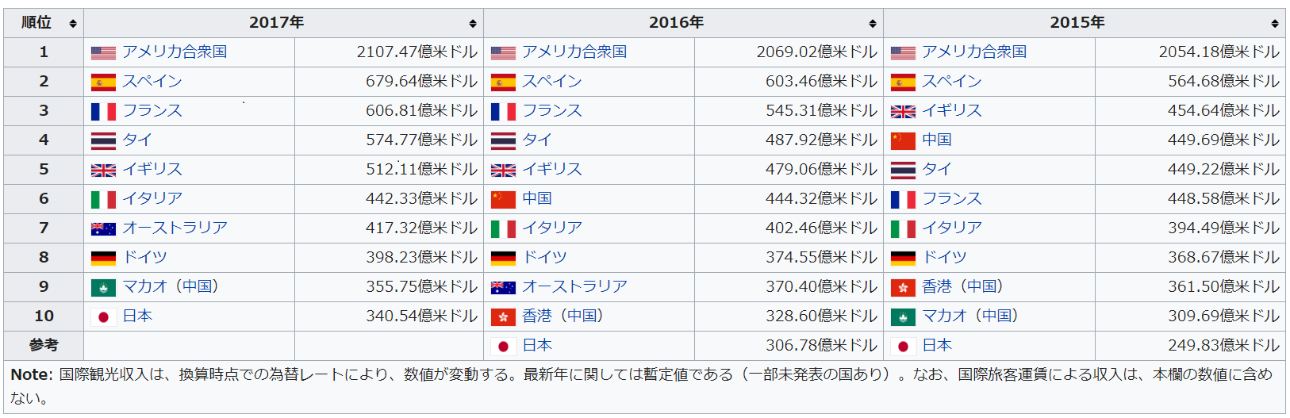
International Tourism Revenue

Slide 6
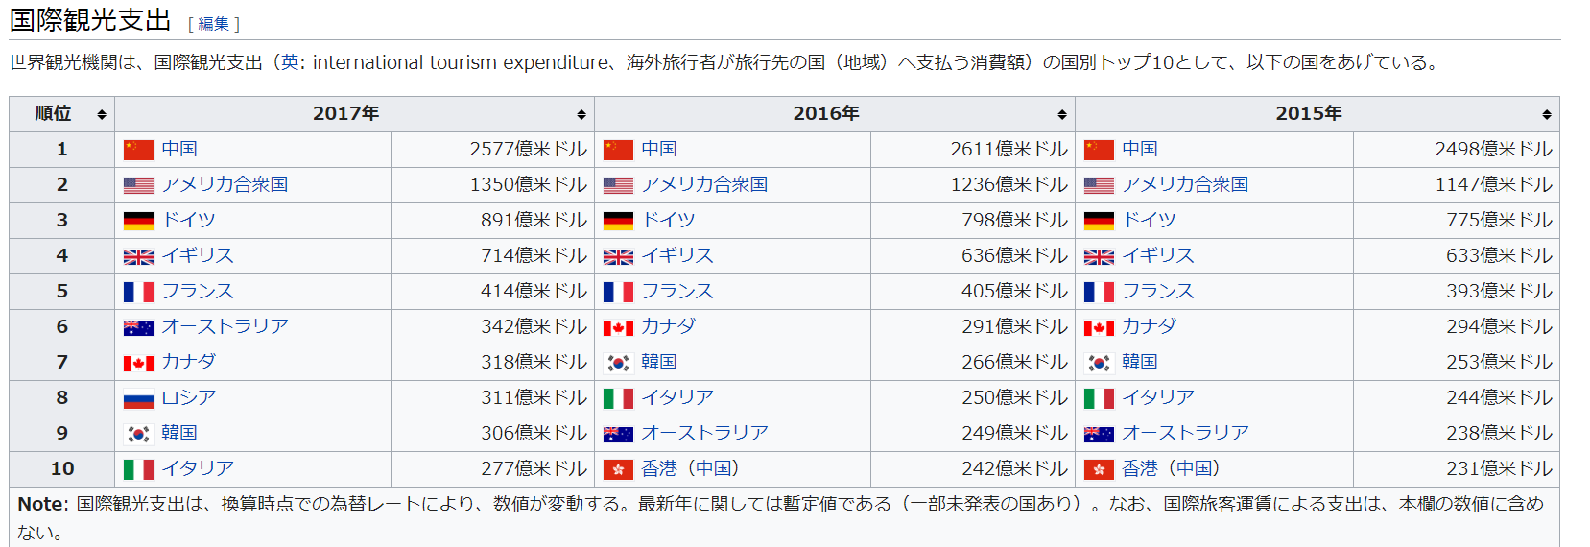
International Tourism Expenditure

Slide 7
The situation in Japan
Japan is no longer a major manufacturing country.
In Japan's international revenue, interest income and intellectual property rights income of foreign currency held are large, and tourism revenue ratio is not large.
However, as the population declines, Japanese countryside expects income from foreign tourists. Therefore, politically, the increase in the number of visitors to Japan is meaningful.
Factors of the increase in foreign tourists visiting Japan are, first of all, improvement of income of the Far East. Secondly, due to the appearance of LCC etc., the cost reduction of air fares and the effect of depreciation of Yen are the effects.

Slide 9
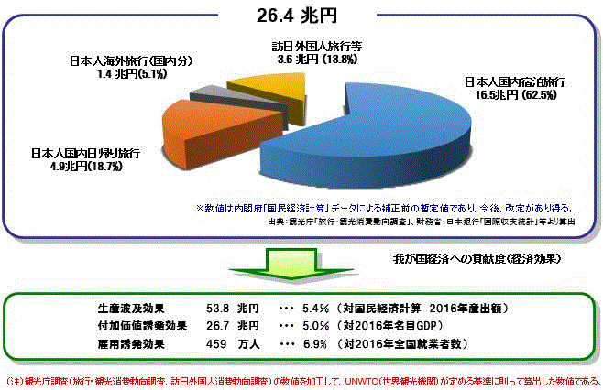
Economic ripple effect of the tourism activity showed by JP GOV.
Foreigner's visit to Japan
Direct economic effect
26.4
trillion yen
Domestic travel with accommodation
Domestic same-day travel
economic ripple effect
53.8
trillion yen
NOTE : This figure is sales including intermediate goods. UNWTO and the National Tourism Organization want to show the numbers big.

Slide 10
Tourism related companies and organizations
Nationality does not matter. Japanese ability is necessary.

Slide 11
Tourism resources system
～ What mind and regulations produce ～

Slide 14
Western-style “Hotel” and
Japanese-style “RYOKAN”
Do you take off shoes?

Slide 15
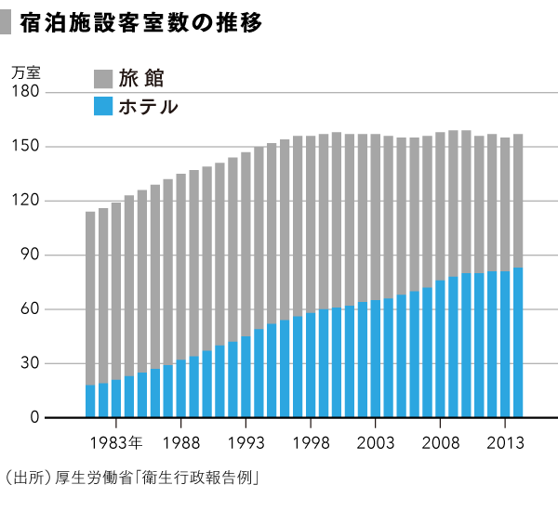
HOTEL（ｂｌｕｅ） and ＲＹＯＫＡＮ（graｙ）
Ten of thousand
Taking off shoes
Not taking off shoes

Slide 16
For western people
Westernization
Relativization
Popularization
Clear differences in lifestyle
(at that time)
For Japanese
people

Slide 17
Japan accommodation can be classified into four
Registration
Dilution of policy significance
Registered Hotel
Registered Ryokan
Non-registered Hotel
Non-registered Ryokan
Non-Registration
Hotel
Ryokan

Slide 18
Law of Renting Private Homes and Rooms
With opportunity to enforce Law of Renting Private Homes and Rooms, according to the Accommodation Business Law, the division of legally separating Hotel and Ryokan was abolished.
However, the legal difference between real estate rental contracts and accommodation contracts is still unclear.

Slide 19
Abolition of tourism interpreter business law
As long as you have the ability, anyone can implement tourism interpreting business.
A national qualification is required only when using the name of 通訳案内士（interpreter guidance）.
But this is a funny thing.
For foreigners, the name of 通訳案内士 in Japanese is not necessary.
Everyone, you can freely in your mother tongue, name an interpreter

Slide 20
Launch of a system for land operators
In order to arrange for travel services in Japan, at the request of a foreign travel agency, qualified persons must be placed.
A qualified person must pass the travel industry administrator exam.
The examination concerns Japanese law, Japan geography, calculation knowledge of rail passenger fare, etc.

Slide 21


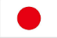
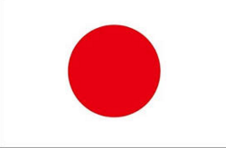
Big Differences in thinking on public transport
Ｂｅｔｗｅｅｎ ＵＫ ａｎｄ Ｊａｐａｎ
ＰＵＢＬＩＣ ＰＲＩＶＡＴＥ
Private Hired Vehicle（PHV）
RAILWAY
ＢＵＳ（common carrier）
street hiring
Black-Cab
Waiting in the garage
Mini-Cab
ＰＲＩＶＡＴＥ
（DRIVER DISPATCH
CAR RENTAL）
Hired Bus
（Carrying business for a fee Using a private car with permission）
BUSINESS USE
compensation
private use
For free
Actual expense claim

Slide 22
Illegal carriage
In Japan, taxi and bus transportation business must obtain permission.
Permitted vehicles have a green license plate.
The driver needs a special driver's license.
However, it is not forbidden to transport it free of charge.
The pick-up between hotel and airport, collection of actual expenses of around 500 yen, receipt of chips is permitted.

Slide 23
Car Rental ＆ Driver Dispatch
It is legal to have a driver dispatched to a private car.
It is recommended to have a driver dispatched on your way home when you drink.
It is recommended for safety if foreign tourists use rental cars to have drivers who understand foreign languages dispatched.
The act of connecting the act of providing rental cars and the act of dispatching a driver functionally using information technology is a recommendation.

Slide 25
2,637 Jun.2018
1,143 Ooita Pre.

Slide 26
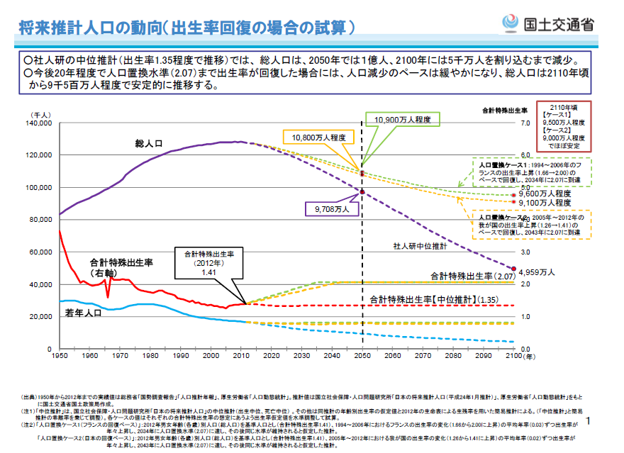
THOUSAND PERSONS
Population of JAPAN
BIRTHRATE

Slide 27
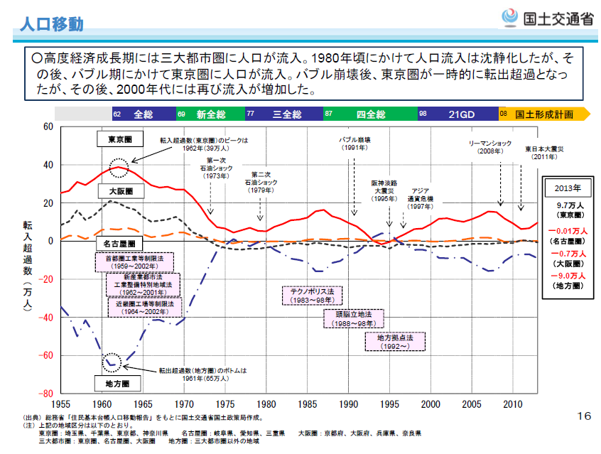
Tokyo's economy can not grow without foreign workers
Red line:Number of people flowing into Tokyo
There is no longer a population flowing from the country into Tokyo.
Blue line: Country population decreased

Slide 28
Immigration Control and Refugee Recognition Act

Slide 29
Business Management Visa
When the applicant intends to engage in the management of trade and other business in Japan
Have 3 years of experience (including period of majoring in management or management subjects at graduate school) about business management or management of project
Receive compensation equal to or greater than the compensation paid when Japanese work

Slide 30
Visa about Knowledge on technology / humanities or international business
http://www.moj.go.jp/nyuukokukanri/kouhou/nyukan_nyukan69.html

Slide 31
Exemplary １
After graduating from the graduate school in Japan majoring in social infrastructure engineering and working at the Institute of Industrial Science and Technology at the university, based on a contract with a sightseeing and transportation consultancy company in Japan, received a remuneration of about 300,000 yen per month, Those engaged in research and development / analysis related work in tourism and transportation.

Slide 32
Exemplary ２
Language school lecturer on sightseeing etc.
After graduating from the university in the home country, based on a contract with a language school in Japan, receiving a remuneration of approximately 250,000 yen per month, engaged in business as a language teacher.

Slide 33
Technical Internship Act
Law concerning the proper implementation of technical internship of foreigners and protection of technical interns
Enforced on November 1, 2017
The purpose is to transfer the skills, technology or knowledge cultivated in Japan to the developing region and contribute to "human resource development" which is responsible for economic development in the developing region
This law stipulates that skill training should not be conducted as a means of adjusting the supply and demand of labor.
Foreign skills intern trainees make employment relations with companies and individual business owners in Japan.
The period is set to 5 years maximum.

Slide 34
New Specific skill visa
Newly revised Immigration Control Act is enforced from April 2019.
The Ministry of Justice expects Japan to accept about 345,000 people in five years from fiscal 2019.
Approximately 45% of them are supposed to shift from foreign technical interns.
In the future, the detail will be determined by ministerial ordinance.

Slide 35
The Reality is ・・・
The skill training system compensates for the shortage of simple workers in Japan. Japanese agriculture is collapsed unless there are foreign workers.
While wanting to expand the skill training system, the government is afraid of political criticism of immigration tolerance.
Therefore, the government has created a category called specific skills, which explains that this is not simple labor.
Actually, because the number of foreign non-Japanese simple workers in Japan further increases, human resources who can specialize in their management are required.

