Slide 1
СИСТЕМА РЕГУЛИРОВАНИЯ РЕГИСТРАЦИИ ЗЕМЛИ
В ТОКИО ЯПОНИИ
LAND Transportation Reguration System
IN TOKYO JAPAN
Шуичи Teлаmae Кандидат наук
Президент
Человеческая логистика & Туризм лаборатория

Slide 2
Сравнение Москвы и Токио
 |  |  |  | Москва | Токио
人口 | население | million | 2016 | 12 | 9
面積 | область | Km^{２} |  | 2561 | 2200
都市圏域人口 | Городской район население | million | 2017 | 17 | 35
名目GDP/人 | Первичный номинальный ВВП на душу населения | thousand US$ | 2014 | 45 （https://matome.naver.jp/odai/2143188196272380201/2146558187806746403） | 58 （http://uniunichan.hatenablog.com/entry/20151230GDP）

Slide 3
Обмен между людьми России и Японии
 | 2012 | 2013 | 2014 | 2015 | 2016
Количество российских посетителей в Японии | 50176 | 60502 | 60542 | 54365 | 54839 | 訪日ロシア人数
Количество японских посетителей | 76212 | 86806 | 105220 | 87280 |  | 訪露日本人数

Slide 4
Coming to Russia for the 2018 World Cup™?
Public transport is free! https://www.rbth.com/travel/328515-russia-free-transport-2018
TRAVEL JUNE 13 2018 ANNA SOROKINA
Use your Fan ID and match tickets to travel across the country - without paying a thing.
1. Get free tickets for Russian trains
2. Use special free buses in host cities
3. Check out other kinds of transport you can use for free
In Moscow, football fans will get all kinds of free public transport on match day except taxis. The metro, Moscow central circle, commuter trains, buses, trolleybuses and trams can be used for an unlimited number of rides, only the Aeroexpress train from the airports can be used no more than twice.
4. Download the Fan Transport Guide
5. Find more opportunities with your FAN ID

Slide 5
Сравнение бизнеса такси между Москвой и Токио（モスクワと東京のタクシー事業比較）

Slide 6
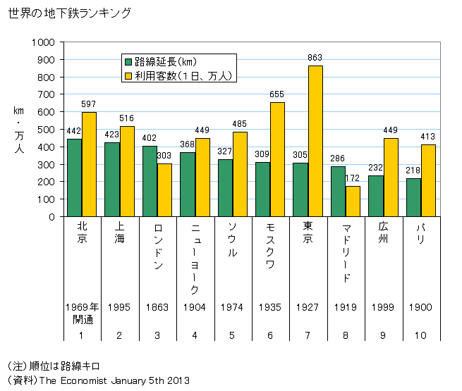
Мировое метро 世界の地下鉄
Расширение маршрута
Количество клиентов
ＬＮＤ
NYC
MOSCOW
ＴＯＫＹＯ
PAR

Slide 7
Illegal taxis soon to be gone from Moscow streets
（2011年モスクワタクシー規制開始の記事） https://www.rbth.com/articles/2011/09/01/illegal_taxis_soon_to_be_gone_from_moscow_streets_13327.html
LIFESTYLE SEPT 01 2011 LARA MCCOY ROSLOF DARIA KOSTINA
A new law intended to regulate the taxi industry goes into effect Sept. 1, but few believe it will have its intended effect.
On Sept. 1, the streets of Moscow will be cleared of “gypsy cabs” – at least according to a new law that enters into effect on that day. Since it was announced, the new law has been the source of frequent, heated debate. Taxi drivers staged protest rallies in major cities and official petitions were submitted to the prime minister.
The law itself does not appear on first glance to be particularly onerous. It requires private taxi drivers to have a permit, and for their cars to be equipped with a meter, an orange light on the roof, and checkerboard stripes painted on the side. The cars will also have to undergo an inspection every six months, and each region has the right to require all taxis to be painted the same color.
The driver must have at least 5 years’ driving experience and must fill out a receipt or a report form for each journey.

Slide 8
Under the new law, taxis will be regulated by traffic police inspectors (GIBDD) and Rostransnadzor, Russia's transport safety regulator. They will attempt to catch unofficial taxis by posing as a passenger and filming the transaction.
There are currently more than 40,000 unofficial taxi drivers in Moscow alone, according to the Moscow Transport Union, an association of Moscow transport companies. These illegal taxis are estimated to earn more than 1 billion rubles in tax-free income annually. In contrast, there are only around 9,000 official taxis in the capital.
Not surprisingly, Moscow’s official taxi companies are strong supporters of the law. “The anarchy caused by private cabs operated by people with no driving experience and no knowledge of the Russian language or the city will come to an end,” said Felix Margarian, general director of the New Transportation Company, which operates taxis under the Yellow Taxi brand. “The illegals who have occupied the approaches to air terminals, train stations and parking places near retail complexes will either gradually legalize their activities or leave the market. I am sure there will be no deficit.”
But the law’s critics argue that it ignores the interests of individual entrepreneurs. “The list of requirements and documents to be submitted by carriers is still to be approved. Putting checkers on the side of the car and a lamp does not cost much. But a taximeter is a different story. Some say the device can be bought for 1,500 rubles, others say you can just install a program on the navigator. If color restrictions are introduced, thousands of carriers will have to repaint their cars. That is expensive,” said Yaroslav Scherbinin, Chairman of the Russian Union of Taxi Drivers.

Slide 9
According to private taxi drivers, the main problem with the new law is that licenses will be issued only to those who own their own cars. Drivers who use cars under a power of attorney will not be allowed. Additionally, it is not clear what the medical check up for drivers and the vehicle safety inspections will entail, nor where these tests will take place and who will administer them.
Almost all unofficial taxi drivers think the new law will be ineffective.
Alexei Krikunov, who has 20 years’ experience as a gypsy cab driver and has no plans to go legal, says it is impossible to catch an unofficial cab.
“I often take passengers who are going my way,” Krikunov said. “If a traffic cop stops me I can always say I am driving a relative.”
That tactic would probably work for Darya Boldyreva.
“I use taxis to get from my home to the office. There are always a couple of cars parked at the same place. I know the drivers well,” she said.
Even passengers that take taxis infrequently do not think that increased regulation will cut down on illegal fares.
“Half the cars that stop to pick up illegal passengers now are legal cabs,” said Anton Zaborov. “The driver is working for this or that company getting orders from the call center, but he still is tempted to get some more 300 rubles by taking an undocumented passenger. I cannot imagine how new laws will change that.”
Nevertheless, Stanislav Krivosheyev, leader of the All-Russia Movement of Taxi Drivers and Editor-in-Chief of the web portal Taxist News, has decided to go legit.

Slide 10
Moscow‘s Taxis Among the World’s Cheapest
（モスクワのタクシー運賃水準） https://themoscowtimes.com/articles/moscows-taxis-among-the-world-cheapest-58666
Moscow is among the cheapest cities to catch a cab, according to the recently released Taxi Price Index 2017.
A ride in Moscow costs $0.27 per kilometer on average the study found, putting Moscow behind just Bangkok and Cairo. At $0.10 per kilometer, the Egyptian capital was ranked the cheapest city in the world.
Taxi prices in Moscow have dropped dramatically since the arrival of app providers, including Yandex-Taxi, Gett and Uber. Last month, Yandex announced it would be pairing up with Uber in Russia.
Moscow taxi regulations are among the world’s most liberal. There are no fixed minimum charges or enforced quotas and taxi licenses are easy to obtain — all of which have pushed fares down.

Slide 11
The study, conducted by the British online car selling platform Carspring, compared prices in 80 cities around the world by wait times, costs per hour and the price from the city's airport to the center.
In Moscow, that journey will cost on average $29.77, according to the ranking.
Visitors to Moscow would do well to take the price as a benchmark. In June, a Chilean journalist who traveled to Russia to cover the Confederations Cup was charged 50,000 rubles ($834) for ride to his hotel from Domodedovo Airport. The driver was later detained by police.
The city that was ranked the most expensive overall was Switzerland’s Zurich, where the price per kilometer is on average $5.19.

Slide 12
Cheapest Cities for Cab Fares https://www.travelandleisure.com/travel-tips/ground-transportation/carspring-taxi-index-cabs
1. Cairo, Egypt: $0.10 per kilometer
2. Bangkok, Thailand: $0.18 per kilometer
3. Moscow, Russia: $0.27 per kilometer
4. Mexico City, Mexico: $0.28 per kilometer
5. Jakarta, Indonesia: $0.30 per kilometer
6. Bangalore, India: $0.30 per kilometer
7. Mumbai, India: $0.32 per kilometer
8. Beijing, China: $0.34 per kilometer
9. Bucharest, Romania: $0.35 per kilometer
10. Kuala Lumpur, Malaysia: $0.36 per kilometer

Slide 13
Most Expensive Cities for Cab Fares
1. Zurich, Switzerland: $5.19 per kilometer
2. Geneva, Switzerland: $3.32 per kilometer
3. Tokyo, Japan: $2.92 per kilometer
4. London, England: $2.89 per kilometer
5. Berlin, Germany: $2.36 per kilometer
6. Amsterdam, Netherlands: $2.36 per kilometer
7. Cologne, Germany: $2.34 per kilometer
8. Copenhagen, Denmark: $ 2.31 per kilometer
9. Antwerp, Belgium: $ 2.25 per kilometer
10. Stuttgart, Germany: $2.25 per kilometer

Slide 14
Thousands of Moscow Taxi Drivers Sanctioned for World Cup Price Hikes
ワールドカップ時のタクシー事情
（参考）2020年は1000万人と予想されている
Nearly 100,000 Moscow taxi drivers have been sanctioned by law enforcement officers for violations including overcharging customers, operating an unlicensed taxi and driving without a license during the World Cup in Russia.
At least 3 million Russian and foreign tourists descended onto Moscow during the month-long football championship this summer. The Moscow branch of Russia’s Interior Ministry investigated 183,000 taxicabs after June 19 following complaints about inflated prices, its deputy chief was quoted as saying.

Slide 15
“Administrative proceedings have been brought against more than 95,000 drivers,” the RBC news website quoted Moscow’s deputy police chief, Sergei Plakhikh, as saying Thursday.
A “majority” of the cases involved price hikes, RBC cited him as saying.
High-profile cases of overcharging around the World Cup featured a Vietnamese tourist who was billed 23,000 rubles ($360) for a ride to Sheremetyevo Airport from Moscow and a Saudi fan who paid 30,000 rubles ($470), according to the Newsru.com website.
More than 1,000 foreigners were ordered to leave Russia and 341 were deported during the World Cup, Plakhikh was quoted as saying by Interfax.

Slide 16
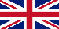
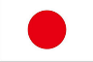
Big Differences in thinking on public transport
ＰＵＢＬＩＣ ＰＲＩＶＡＴＥ
RAILWAY
PUBLIC ＢＵＳ
（as common carrier）
Street-hiring ＆non-ride-sharing vehcle （DRIVER＆ at most ９Passenger）
Non-street-hiring&non-ride-sharing Vehcle（DRIVER＆at most ９Passenger）
ＰＲＩＶＡＴＥ CAR
（including DRIVER-DISPATCH,
CAR-RENTAL）
Non-Street-hiring ＆non-ride-sharing Vehcle①（DRIVER＆at least 10 Passenger）
Permission strictly difficult
Tax preferential treatment for commuting expenses
Non-street-hiring Vehcle②
Ride-Sharing with permission
private use(Non-Paid including actual expense claim）
PUBLIC（Paid transport）

Slide 17
Большие различия в мышлении на общественном транспорте
ОБЩЕСТВЕННОЕ ЧАСТНЫЙ
ЖЕЛЕЗНОДОРОЖНЫЙ
ПУБЛИЧНАЯ АВТОБУ
（ как общий перевозчик ）
Стрит-найм такси （ 1 ВОДИТЕЛЬ или не более 9 Пассажир ）
Non- Стрит-найм такси （ 1 ВОДИТЕЛЬ или не более 9 Пассажир ）
ЧАСТНЫЙ АВТО（ включая
ПРОКАТ АВТОМОБИЛЕЙ Отправка драйвера ）
Non- Стрит-найм такси ① (
1 DRIVER и не менее 10 пассажиров ）
Разрешение строго трудное
Non- Стрит-найм такси ②Совместное использование Ride с разрешения
Налоговый льготный режим для поездок на работу
частное использование
ОБЩЕСТВЕННОЕ （ Платный фрахт ）

Slide 18
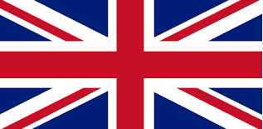
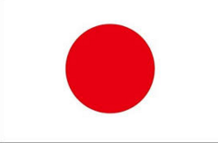
Big Differences in thinking on public transport
Ｂｅｔｗｅｅｎ ＵＫ ａｎｄ Ｊａｐａｎ
ＰＵＢＬＩＣ ＰＲＩＶＡＴＥ
Private Hired Vehicle（PHV）
RAILWAY
ＢＵＳ
（commoncarrier）
street hiring
Black-Cab
Waiting in the garage
Mini-Cab
ＰＲＩＶＡＴＥ
（DRIVER DISPATCH
CAR RENTAL）
貸切バス
（Carrying business for a fee Using a private car with permission）
乗合タクシー（許可）
private use
For free
Actual expense claim
BUSINESS USE
compensation

Slide 19


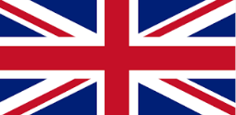
Building a database on human movement
Depends on the ability of the driver
Improvement of demand prediction accuracy by using database
Improvement of dispatch algorithm
Dilution of distinction between street-hiring and business waiting in the garage
Continuation of street-hiring
Black-Cab
OWNER DRIVER
Cab FREET
in Tokyo
Popularization of PHV
Us,uk Japan
Mini-Cab
Uber,Lyft
Shortage
IN NYC,LONDON
Excess
In Tokyo
Number of street-hiring cars
DEMAND
DEMAND
SUPLY
SUPLY

Slide 20
Создание базы данных о человеческом движении
Зависит от способности водителя
Улучшение точности прогнозирования спроса с использованием базы данных
Улучшение алгоритма отправки
Разбавление разницы между уличным наймом и ожиданием бизнеса в гараже
Продолжение уличного найма
Black-Cab
OWNER DRIVER
Cab FREET
in Tokyo
Popularization of PHV
Us,uk Japan
Mini-Cab
Uber,Lyft
Недостаток B NYC, LONDON
Избыток в Токио
Количество уличных автомобилей
СПРОС
СПРОС
ПОСТАВКА
ПОСТАВКА

Slide 21
Езда вместе
омнибус
запланированное
ПО ТРЕБОВАНИЮ
It is not supposed by the Road Transport Law
Стрит-найм
,BUT・・・
Фиксированный маршрут

Slide 22
Transport administration in Japan
Unlike Western countries, The supervision of land transportation projects such as taxis and buses is the authority of the central government.
The transportation system operated by the municipality receives the same treatment as the private shipping company.
Municipalities are responsible for road management administration and traffic police administration, and state agencies are in charge of transportation business regulations.
The historical reason why state institutions are in charge of regulations on transportation business depends on the fact that the railway was state-run long ago. However, the National Railways is now privatized.

Slide 23
Metropolitan Passenger Traffic (in Tokyo)
The principal railroads in central Tokyo are operated by such as JR East and Tokyo Metro Company (the state and the Tokyo Metropolitan Government contribute 50% each) and the Tokyo Metropolitan Government.
Regarding public buses, in the Tokyo metropolitan area these are managed by Tokyo Metropolitan Government and in the suburbs are operated by private companies.
As for the taxi business, private companies and individuals operate and are supervised by state agencies. Also there are no difference legally between street-hailing and non-street-hailing. These two points are differences between Tokyo and New York / London.

Slide 24
Столичный автобусный транспорт (в Токио)
Центральная станция
район, управляемый Токио-Митрополитом-Правительством-Автобусом
JR Ｃｉｒｃｌｅ train LINE
JR Ｃentral train LINE
Route with possibility of ride sharing
Shinjuku Station
Late night,
early morning
Поздно ночью,
раннее утро
Небольшая общественная автобусная служба
Небольшая общественная автобусная служба
Небольшая общественная автобусная служба
Небольшая общественная автобусная служба
Центральная станция
Central Station
Маршрут с возможностью совместного использования
Small community bus operated
City authority
Небольшая общественная автобусная служба
район, управляемый частной транспортной автобусной компанией

Slide 25
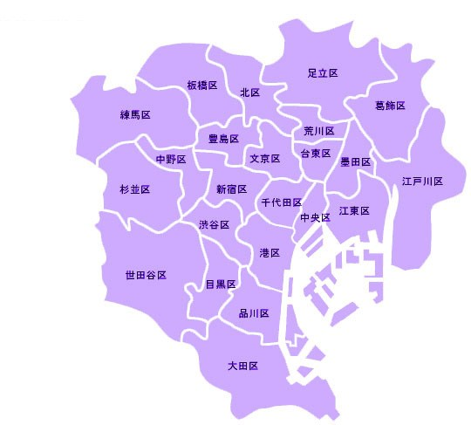
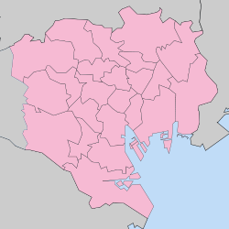
⑥
⑩
②
③
⑤
１．港区 903.7万円
２．千代田区 762.9万円
３．渋谷区 683.6万円
４．兵庫県芦屋市 567.1万円
５．中央区 546.8万円
６．文京区 545.6万円
７．目黒区 526.7万円
８．世田谷区 502.5万円
９．武蔵野市 479.5万円
10．新宿区 475.3万円
⑧
①
⑦
HANEDA airport

Slide 26
Ridesharing by real Taxi-sevice
From 22th Jan. to 11th Mar. Government-led demonstration experiment using 949cabs is going to start in TOKYO Grater Zone.
Not-flat-rate, Special application
Example of failure MAAXI
CONVERSION TABLE FOR USE IN CALCULATING SHARED FARES In London

Slide 27
Mysterious Japanese Travel Bussiness Act System
On-Demand-Service by Vehcle is not supposed by Transport Act, but could be delivered by Travel business Act.
The Reason is easily understood through the next figure.

Slide 30
Urban and rural transport issues
In Japan, paid transport by private car is prohibited. Therefore ride-sharing has become a social problem. There are not many inconvenience for users because there are many taxi supplies in big cities in Japan.
The occurrence of a traffic accident of the elderly and the return of the driving license of the elderly become a social problem.

Slide 31
JERON TAXI
AS Malti-Package-Tour
Elderly driver problem
Monthly Fixed Rate
Hospital
convenience store
Railway station
Home
Emergence of new terms and conditions
Handling of compensation during home
Itinerary guarantee responsibility
All you can use
Special compensation responsibility

Slide 32
Reference material

Slide 33
Mystery of package tour fare system
The combination meal of McDonald is cheap rather than placing an order for the same thing individually. The price of package tour is also the same. However, the regal system of railroad, automobile, aviation and shipping have regulations about fares. The accommodation fare of registered international tourist hotels is based on the pre-notification system. Therefore, prices cannot be decided freely if the price of package tour doesn’t receive the application of regulatory systems. However, various products are sold practically. Besides explanation is impossible and becomes near, if there will be all the applications of the foreign fare rate regulation about the overseas package tour. Interest leans on the institutional explanation of this.
Travel agency decides prices of package tour by himself as his own services. Irrespective of the regulation fare about movement or stay, it sells at all inclusive price (pack price) by his calculation. Since products of the self are sold, naturally the contract responsibility for consumers occurs. The person bearing this contract responsibility is travel agency. It is not the agent of transport organization and the staying organization.

Slide 34
Supposing the contractual liability of travel agency was lower than the liability of transportation business and lodging industry, it began to be recognized to be a problem. Each transportation business law and the Act on Development of Hotels for Inbound Tourists are the laws which control the relation of B2C (Business to Consumer) aiming at user protection. The relation of B-2B (Business to Business) is not assumed directly.
In case of package tour, there are three relations, the relation between real user and real shipping agency, the relation between travel agency and real shipping agency, and the relation between real user and travel agency.
Pains will be taken over the rational explanation as the whole if regulation of the transporting method starts these three relations simultaneously. For this reason, in railroad administration, it was presupposed that there is no application of regulation in B2B.

Slide 35
Single article package tour
～mysterious merchandise uniquely in Japan～
A package tour has nuance called the combination of two or more things as the name suggests. However, a single article type package tour developed actually. The appearance of these products including a single article type package tour promoted price competition, and had big influence on the structural reform of passengers transport enterprise.
In EC, when specifying a package tour, it is specified that it contains two or more [such as transportation and stay] at least, and what is called a single article type is eliminated.

Slide 36
Travel agencies purchase many guest rooms for package tour products creation beforehand. However, travel agencies sold guest rooms alone because guest rooms did not remain unsold when travel agencies purchased guest rooms even more. This is the beginning of single article package tour.
The inclusive tour discount excursion fare currently based on regulation of the Aviation Act is carried out on condition of "two or more combination", 24 hours and an "overnight-stay" rule. This is because the airfare is created in accordance with the international rule.
About single article package tour, there is also voice which a difference with an arrangement travel is hardly known, and its social significance is called into question. Single article package tours promoted competition in the world of real transportation, and they developed structural reform of human logistics. In addition, in Taiwan, single article package tours are admitted.

Slide 37
Monthly riding free fixed amount fare
Transport company "UBER" which Google financed struck Japan. There was not the spotlight as having been introduced to be "the landing calmly" in Japanese Magazine FACTA. Although this UBER does business as a tourist agency, it is judged that service is provided not as a package tour but as an arrangement travel.
There is still much distance, but in UBER I feels the thing which I expected in the book which I wrote as “Mobile-Transport Revolution”. Aside from expectation to UBER, I name the virtual fixed amount taxi as the package tour product “YUBI-TAXI” as follows and describe it as follows.

Slide 38
(Monthly riding free fixed fare amount taxi YUBI-TAXI)
If I call YUBI-TAXI from a smart phone in Tokyo, the car position map which specified the arrival times and the current position in which I am present will appear on a screen.
At the time of traffic congestion in rainy days, if refusing riding together, the display of the charge added to the already paid free-ride fare comes out. This simulated fixed system is not incorporated with the regulation fare of present taxi. Then, why is this system possible?
In fact, YUBI-TAXI is travel service. It is the same as the package tour service which JTB etc. sell. Package tour service is the service created in self calculation. The taxi services which constitute the product are parts. As for the prices of parts, it is nonrelated to users.
If you go to a convenience store at night, the stay coupon of reputable hotel in the metropolitan area is sold for $50 by machine. As the Act on Development of Hotels for Inbound Tourists, since many metropolitan area reputable hotels serve as a notification charge, they cannot change a charge dexterously. Therefore, this coupon is sold as package tour of travel agencies. It is just the same as YUBI-TAXI.

Slide 39
Next, is road transport laws system applied between YUBI-TAXI which is a travel agency, and a taxi company which is a real transporting agency or not? That is the problem. If it says from a conclusion, according to the governmental custom, it is not applied between them. The transport system of a bus and a taxi used the railway law system of Japan as the sample, and were made. A fearful law called the JNR Fare Law existed, because the JNR fare was presupposed like the tax that the concrete amount of money must be defined by law.
When the JNR Fare Law was applied between JNR and travel agencies, package tours are not made. Naturally it was understood that it isn’t applied between them. By thinking naturally, the system of a bus and a taxi which were located in the outskirts of the JNR system also was the same. Therefore, the regulation of the road transport law isn't applied between a taxi company and YUBI-TAXI.
This point differs from the Aviation Act system which institutionalized a special fare for package tours called package rates by IATA or administration. Furthermore, it is more complicated to understand the legal character of package tour price.
Although it is natural, an employment agreement is not between YUBI-TAXI and Taxi Driver. It is a taxi company that signs an employment agreement with Taxi Driver. The same may be said of labor conditions.
What kind of legal relations between YUBI-TAXI and real users is? It is said YUBI-TAXI will take the special compensation responsibility and the itinerary guarantee responsibility.

Slide 40
About the itinerary guarantee responsibility, it teaches us that a basic problem exists in Travel Agency Act. Although there was also an opinion to which it is insisted that the same contractual liability as a transporting agency should be taken. However, it would be hesitated until now at this stage when a travel agency could not control the real service of the overseas transportation company.
However, because YUBI-TAXI can grasp the service of the car every moment through smart phone system, it is reasonable that the transport guarantee responsibility is taken by YUBI-TAXI.
In the current Travel Agency Act, existence of "the use transport business of using real transport service" to take the transport responsibility is prescribed. If YUBI-TAXI takes form of the use real transport, it gets closer to human logistics.
Finally I suggest "monthly riding free fixed amount fare (monthly unlimited flat rate price)". If a real taxi business can adopt this fare as its transport system, there is no problem. However, it is actually difficult for introduction to obtain an understanding of government.
Although the Taxmobil concept was proposed in south Germany, there is a strong opposition from a labor union and it has not yet realized. Therefore, introducing as a package tour price is realistic.
One of the structures which do not show a cost price is a fixed amount use free system. The charge of the cell-phone is representative. The appearance of the smart-phone may greatly change business model of human logistics. The appearance of the package tour product which evolved is expected. You can use a bus, a taxi and service of other transportation by a monthly fixed rate without any restriction.
It may be necessary to create the new "human logistics" concept that is beyond the concept called the itinerary.

