Slide 1
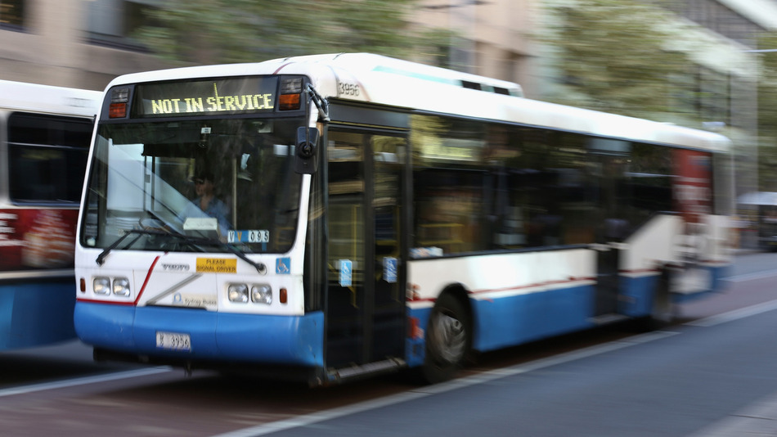
Transport app Moovit has arrived in Australia
http://mashable.com/2015/03/30/transport-app-moovit-australia/#:eyJzIjoiZiIsImkiOiJfeW80dTUya2M5cGVmdG95dSJ9

Slide 2
There's a new player in town that plans to get us moving at a faster pace, using the power of people and public transport.
Moovit, a startup founded in Tel Aviv, Israel, has launched its transportation app in Australia. The app is much like other transport apps available in Australian cities, but the company hopes to create a national network, instead of the current state-based systems.
The app is currently available in Sydney, Melbourne, Brisbane, Canberra, Adelaide, Hobart and Perth, and already has secured more than 200,000 users from beta trials. If it sees the same success locally that it has seen across the world, it will no doubt increase those figures rapidly.
When planning a trip, Moovit will detail how to get to your destination in the quickest way possible using multiple forms of public transport. It allows you to favourite stations, see alerts from transport authorities and check out schedules.
Moovit's key point of difference is its ability to crowdsource information to give other users a real-time snapshot of what's happening on their planned route, such as disruptions, crowds or cleanliness. Moovit wants its global app — it is now in used by more than 15 million users in over 500 cities — to feel local, and it tries to achieve this by sourcing constant user feedback.
Alex Torres, who spent nine years in senior roles at Google on products like Google Maps, is now Moovit's head of global product marketing. He spoke to Mashable about the company's plans to expand rapidly into Southeast Asia, starting with Australia as a base.
"The key for Australia, and why we believe in the country and the model from our side, is the community part. We do believe Australians are really committed, we currently have more than 200,000 users and we haven't openly launched it," Torres said.
"We want to make local transportation easy. You can plan a trip, you can get a schedule, you can favourite your lines and the trips you want to have," Torres said. "You can also use your app in any city around the world, in the language it has been set."

Slide 3
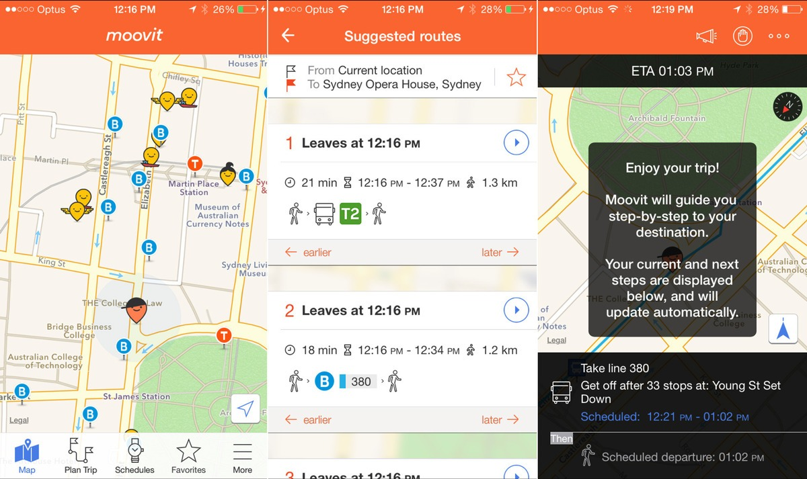

Slide 4
The start-up, headquartered in San Francisco and Tel Aviv, was founded by Nir Erez, Roy Bick, and Yaron Evron in 2012, and in January secured a US$50 million investment from Nokia, BMW, Sequoia, Bernard Arnault Group, Vaizra Investments, BRM Capital and Gemini Partners. It will allow the startup to spread its wings even further, with growth to more local markets high on the radar.
Torres said bringing "multi-model transportation" to the world is "the future" and Moovit wants to have customers use the product to change a situation rather than simply complaining about it, as is often seen on social media. The app also encourages transport authorities to listen to their customers.
"The power of the data is there, but we do it in a way that is private and anonymous," Torres said. "We are extremely open to having a conversation with the transport authorities so they can use customer feedback."
Monetization of the app is not a main focus at the moment for Moovit, its philosophy is that making money should be through means that do not affect the free model or the user experience.
"There could be mobile ticketing, tax integrations and partnerships with certain brands that highlight their points of interest on the map, there are so many possibilities but you need to ensure the user experience remains the same," Torres said.

Slide 5
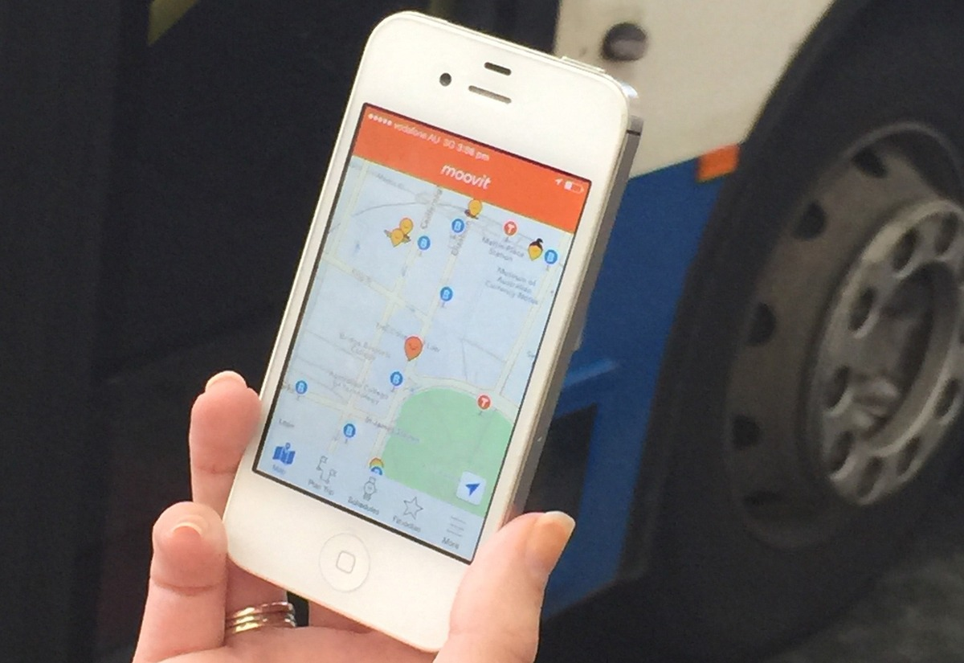

Slide 6
The company doesn't currently have partnerships in Australia, but are open to any opportunities with private transport companies, such as the deal they have with Lyft in the U.S., where a user can be alerted that it will be quicker to jump off the transport mode they are on and into a waiting car.
In the major Australian cities, currently the app isn't a standout from Google Maps, which integrates Uber into its route selections and offers a multitude of public transport options. This is not the case for Melbourne's transport system, which isn't yet on Google Maps, but is expected to be in the coming days. Melburnians will be happy to have an option at their fingertips starting now, after waiting a long time to get in sync with the rest of the world.
Alex says the main difference is how Moovit garners people power to help others get around by flagging disruptions and issues while the community helps build up the app in more regional areas, whereas Google's coverage may be patchy. The differences will likely be seen locally over time as Moovit grows in Australia.
Moovit is available for iPhone, Android and Windows Phone. It will also be available on Apple Watch when it launches in April and Android Wear.

