Slide 1
都市の魅力 訪問者数で競う時代
外国からの旅行者数
都市別トップは？

Slide 2
ＣＮＮニュース ２０１３年の観光客数 ロンドンの世界一宣言 パリが反論

Slide 3
英国家統計局、２０１３年７～９月にロンドン訪問客は４９０万人、前年同期比２０％増加、過去最高。このペースなら年間１６００万人超
市長はロンドンの魅力について「博物館、美術館があり、劇場も世界一充実。欧州の都市で最も緑が多く、スポーツの競技場も多い、犯罪発生率が低い。世界中から人々が集まってくるのも不思議ではない」
2013年はオリンピックに加え、ウィリアム王子とキャサリン妃の長男が誕生、ウェストエンドで人気ミュージカル「ブック・オブ・モルモン」が上演。ロンドン塔、セント・ポール大聖堂等の観光名所も、来訪者が前年を大きく上回

Slide 4
パリの反論
パリ副市長は「五輪の前後はロンドンに人が集まったかもしれないが、世界一という触れ込みは事実に反す」と主張
１２年のデータによると、近郊を含めたパリ大都市圏では国内外からの観光客が合計２９００万人に達した。これに対し、１０倍の面積があるロンドン大都市圏の観光客は２７６０万人にとどまったという。

Slide 5
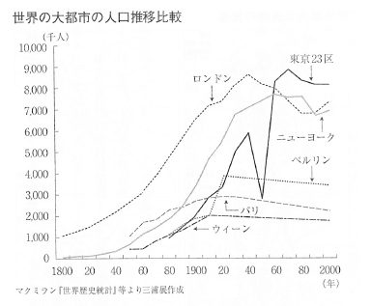

Slide 6
OUR PLAN FOR LONDON'S ROADS
http://www.tfl.gov.uk/campaign/our-plan-for-londons-roads?intcmp=23082
https://www.youtube.com/watch?v=qL02__XuUfI

Slide 7
Knowledge
https://www.youtube.com/watch?feature=player_detailpage&v=3pKeZll_b4o

Slide 8
4種類の動画で紹介 http://www.tfl.gov.uk/info-for/taxis-and-private-hire/become-a-taxi-licensee?intcmp=3521
Go Your Own Way is a DVD produced by Transport for London. It explains what you need to do to learn the Knowledge.
https://www.youtube.com/watch?v=Xbai9iHm-e0
https://www.youtube.com/watch?v=ONyJIPgjt-w
https://www.youtube.com/watch?v=X-mpCyanub4
https://www.youtube.com/watch?v=jVs7z7iQwoc

Slide 9
Taking the taxi driving test
http://www.tfl.gov.uk/info-for/taxis-and-private-hire/become-a-taxi-licensee/learn-the-knowledge-of-london/taking-the-taxi-driving-test
Before you can become a licensed taxi driver, you need to pass a taxi driving test.
The test, which takes about one hour, includes a driving test in a licensed taxi. Here, you will be asked to carry out a series of driving manoeuvres.
At the end of the test the examiner will ask you a series of questions from the Highway Code on road signs.
Know your vehicle
Make sure you are familiar with the facilities in the taxi, such as the swivel seat and the intermediate step. You will also need to show how to correctly load, secure and unload an empty wheelchair.
You can get more information about the taxi driving test and what to expect from it in the short film, Taking the taxi driving test.

Slide 10
https://www.youtube.com/watch?v=B4AEnmt2o5c Taking the taxi driving test - video transcript
As well as a general overall level of competency the examiner will be looking for evidence that you can drive safely in a congested area.
You will also need to know how to use the facilities such as the swivel seat and the wheelchair ramp to assist those with a disability.
Okay Trevor, the first thing we're going to do is get you to read a number plate.
So if you just stop here for a moment.
Okay, so see the vehicles there ahead of you there, if you can read the number on the vehicle on the far left for me.
Most people when they arrive at the test centre to take a test they will feel quite apprehensive, after all they are coming for a test.
However, they probably won't feel the same nerves that they felt when they took their original L test because these are experienced drivers and usually they've got a fair amount of confidence.
They are quite worried at the fact they've been driving for several years and then all of a sudden somebody's going to be staring at them and watching every move they make whilst they drive and whilst they load the wheelchair on to the vehicle.
So yes I think a certain amount of nerves would be expected and quite often people do perform very well even though they are slightly nervous at the time.

Slide 11
The reason why it's important to have this test is it's vitally important for road safety that the fare paying passengers can get from A to B both in comfort and in safety.
Because these are experienced drivers they may have picked up some habits so it does no harm for these drivers to have a look at their own driving and sort of do a bit of self assessment if you like.
And get some driver training behind them so that when they're taking passengers from A to B those passengers have confidence in the service that they're providing.
The test in its entirety is about an hour. The first part or the largest part of that is probably about 38 to 40 minutes, would be the driving element of the test.
So there's some general driving on a variety of road and traffic conditions.
I'll ask them to do two manoeuvres, one of which will be what they call a taxi manoeuvre exercise, which is a manoeuvre where the candidate chooses which way they want to turn the vehicle round and from that I will then choose a second manoeuvre accordingly.
Now with the general driving I might ask them to do an emergency stop and there will be several times during that drive where I'll pull them up at the side of the road either to see them move off from behind a parked car.
Or move off on a hill or just normal stop as if they were picking up or dropping off a fare paying passenger.
After that element of the test the next part would naturally be the wheelchair exercise.
So during this exercise the candidate would have to demonstrate how they would load an empty wheelchair in and out of the vehicle using the ramps, using the harnesses and the seatbelts that are supplied.
The DSA would provide the wheelchair for this exercise but the main point of this is that they imagine that there was somebody in this wheelchair and they can load it safely and with due concern to the passenger that might be in that chair.
Following that there are some questions both on the Highway Code and matters relating to the safety of the vehicle.
I also ask the candidate to identify some traffic signs, and that's it then, after that then I would give the candidate the results of the test and that would be over.
Okay, that's the end of the test and I'm very pleased to say you've passed.
Thank God for that.
Congratulations.
Thank you. That's great.

Slide 12
Apply to be a taxi proprietor

Slide 13
The majority of the 20,000 taxi vehicles currently licensed are owned and driven by individual licensed drivers.
However, a significant number are owned and maintained by individuals and companies. They rent them out to licensed taxi drivers who do not own a vehicle.In order to become an approved London taxi proprietor you must meet be aged 21 or over.
When an individual or company applies to become a proprietor, we will take the following into consideration:
a. An applicant's criminal record via a Disclosure and Barring Service (DBS) check b. Any offences under taxi legislation c. Any previous history as a proprietor d. Whether the taxi itself is fit for purpose

Slide 14
BECOME A PRIVATE HIRE LICENSEE
Any private hire driver or operator must be licensed by us. And whether you're offering minicabs, limousines or another driving service, you'll have to get your vehicles licensed too.

Slide 15
There are licensed operators all across London, offering a variety of services. Once licensed, you can drive in any part of London.
In order to be licensed, you will need to meet the following criteria:
You must be at least 21 years of age at the time of applying. There is no upper age limit, as long as you meet the other licensing requirements
You must hold a full DVLA, Northern Ireland, or other EEA state driving licence that's at least three years old
You must have the right to live and work in the UK
You must be of good character. To establish this you will be required to undertake an 'enhanced' criminal records check from DBS through our service provider - GBGroup
You must be medically fit which means meeting the DVLA Group 2 standards. In most cases, this will mean that you will have to undergo a medical examination with someone who has access to your full medical history
You will need to undertake a topographical skills assessment from an accredited assessment centre

Slide 16
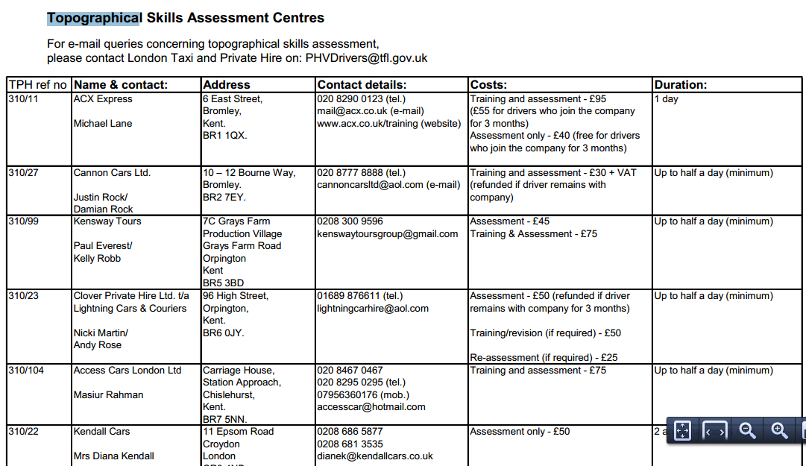

Slide 17
Don't take an unbooked cab
Do not take an unbooked minicab thinking that you will be safe just because:
The driver is smartly dressed
You have taken down the number plate as an insurance policy
You only get a minicab if you are in a group - safety in numbers
You talk to a friend on your mobile on the way home for reassurance
You have approached the minicab
https://www.youtube.com/watch?v=zMA9obnEVF4

Slide 18
taxi rank
客を待っているタクシーが待機する場所
(a place where taxis park while awaiting customers)
in England the place where taxis wait to be hired is called a `taxi rank' イングランドで、タクシーを拾うために待つ場所は、『taxi rank（タクシー乗り場）』と呼ばれている

Slide 19
Marshalled taxi ranks
To help you get home by taxi, or private hire vehicle, late at night there are several marshalled taxi ranks and private hire pick up points operating around the Capital.
This list shows the times and days the taxi rank schemes normally operate, but these are subject to change. The marshals may occasionally be at the taxi ranks at different times, or marshalling different taxi ranks.

Slide 20
ブラックキャブとミニキャブの紛争
https://www.youtube.com/watch?feature=player_detailpage&v=jQDSKhIXAEY
https://www.youtube.com/watch?v=QNhQzeIGZ_8&feature=player_detailpage

Slide 21
Satellite navigation vs taxi - Auto Express
https://www.youtube.com/watch?v=z-Ne-BQFueM&feature=player_detailpage
https://www.youtube.com/watch?v=hW6nPfSqRRg&feature=player_detailpage

