Slide 1
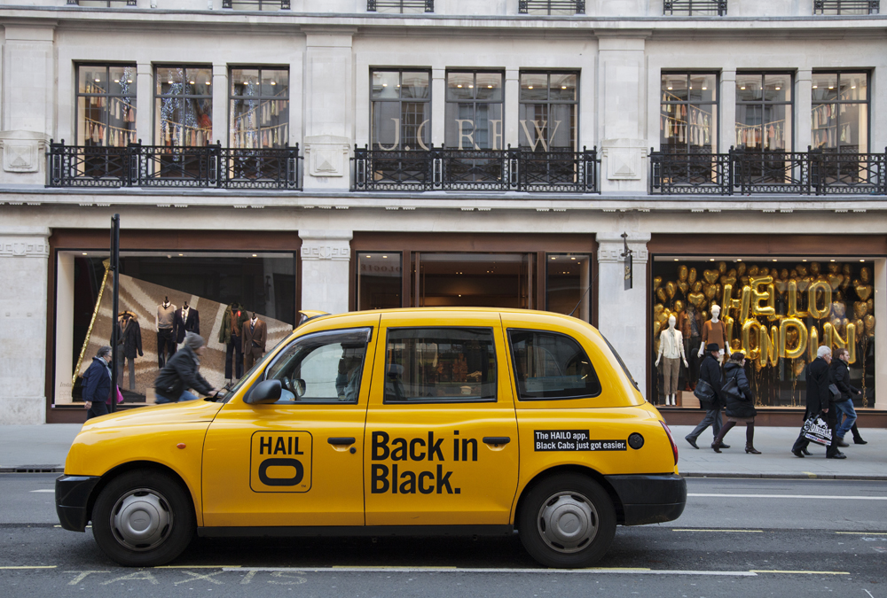
Hailo情報

Slide 2
投資家
Hailoは、Union Square Ventures, Accel Partners, Wellington Partners, Atomico VenturesそしてSir Richard Bransonを含む著名なベンチャーキャピタルから総額10,000万ドル以上を調達しています。
2013年の終わりから2014年の初めにかけて、ヘイローは とアジアの投資家グループからさらに5,000万ドルの資金提供を受けました。これは世界20都市以上で展開する私たちの事業の成長を促進し、複数のグローバル市場に向けた拡大と発展の原動力となる十分な財源を確保するためのものでした。

Slide 3
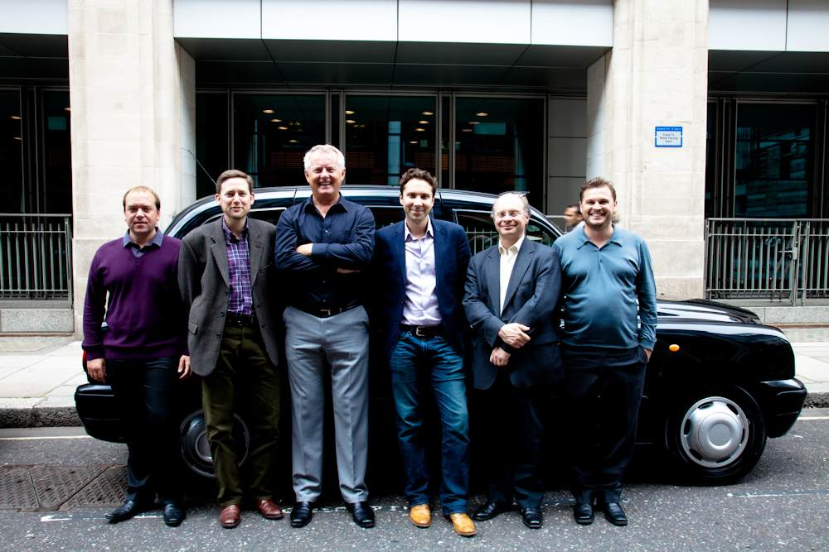
創始者

Slide 4
Passenger Terms & Conditions of Service
Hailo is a technology platform that brings together global service providers with mobile customers ("Hailo") provided by Hailo Network Limited ("we", "us" and "our"), company number 07477274, registered at 111 Charterhouse Street, London EC1M 6AW, email support@hailocab.com. Click here for more details about Hailo. For information on how we will use your personal data, please see our privacy policy. Please see our Terms & Conditions for Drivers here.

Slide 5
1. YOUR USE OF HAILO
1.1 You can only use Hailo where you have registered to do so.
1.2 You agree:
1.2.1 and promise that all information and details provided by you to us (including on registration) are true, accurate and up-to-date in all respects and at all times. You can update or correct your details at any time via the Hailo app;
1.2.2 your use of Hailo grants you no rights in relation to our intellectual property rights (including, without limitation, copyright, trade marks, logos, graphics, photographs, animations, videos and text or rights in and to Hailo software, applications and website) or the intellectual property of our retail or advertising partners, other than the non-transferable, personal right to use and receive the Hailo services in accordance with these Terms;

Slide 6
1.2.3 that you will not use Hailo: for any unlawful purpose; in any way that interrupts, damages, impairs or renders Hailo less efficient; to transfer files that contain viruses, trojans or other harmful programs; to access or attempt to access the accounts of other users or to penetrate or attempt to penetrate any security measures; to disseminate any content which is defamatory, obscene, or may have the effect of being harassing, threatening or abusive to an individual or group of individuals on the basis of religion, gender, sexual orientation, race, ethnicity, age or disability or otherwise; to advertise or promote third party or your own products or services;

Slide 7
1.2.4 to refrain from doing anything which we reasonably believe to be disreputable or capable of damaging our reputation;
1.2.5 and acknowledge that we have limited control over the nature and content of information and chat transmitted or received by you or other users of Hailo. Although we reserve the right to do so, we do not monitor such content in the usual course of business and will not be liable for any such content. If you have a complaint about another user please contact us via the app orwebsite;
1.2.6 that you will comply with all applicable laws;
1.2.7 to make payment in full to any taxi drivers introduced to you through Hailo for any services provided by such driver to you (although you may choose to use the Hailo app to facilitate such payment);

Slide 8
1.2.8 to treat taxi drivers introduced to you through Hailo with respect and not to cause damage to their taxi or engage in any unlawful, threatening, harassing, abusive behaviour or activity whilst using their taxi or the Hailo service;
1.2.9 to compensate and defend us fully against any claims or legal proceedings brought against us by any other person as a result of your breach of these Terms.
1.3 Please note that we are not responsible for the behaviour, actions or inactions of drivers of taxis which you may use (through Hailo or otherwise). Any contract for the provision of taxi services is between you and the driver and not Hailo and we simply provide a platform to introduce drivers and passengers.

Slide 9
2. CHARGES AND PAYMENT
2.1 For details about the cost of taxi journeys with Hailo click here.
2.2 If you choose to pay for a taxi ride through Hailo then such payment will be taken automatically at the end of the journey using the card details you registered with us and which we will store for such purpose. You agree that we may undertake authorisation checks on that card when you first join as well as when you order a Hailo taxi.
2.3 When you join Hailo, you will be given the option to pre-set a default "tip" percentage of your choosing. This will automatically be added to the taxi fee at the end of each journey unless you choose to override it with a different tip amount or to remove the tip. You can re-set the tip default amount at any time by updating your profile details via the app.

Slide 10
2.4 Once you have taken a taxi journey with Hailo you won't be able to cancel (since the service has already been provided) and your payment will be taken automatically and is non-refundable. If you have any complaint in relation to the taxi service provided then that dispute must be taken up with the taxi driver directly. If you are unable to resolve the dispute with the taxi driver or you cannot come to an agreement with the taxi driver, please contact Hailo and we will try to resolve the dispute.
2.5 In relation to any taxis organised for you through Hailo you also agree to pay additional charges (for example where you then do not complete that journey or cancel when a taxi has already been allocated to you or for any damage or cleaning costs to the taxi which you incur) as set out in more detail here:
Cancellation. We reserve the right to charge a £5 cancellation fee if you cancel an order after a taxi has been allocated to your job. View our Cancellation Policy.
Cleaning: You will be charged £40 if after your journey the taxi requires cleaning.
Damage: You will be charged at cost for any damage to the taxi caused by you.

Slide 11
How much does it cost?
The app is free to download, there are no hidden fees and Hailo doesn’t charge to come and pick you up. Plus, uniquely to Hailo, our drivers will wait 2.5 minutes for free when they arrive at the pickup location. Our drivers do not charge a ‘Run In Fee’ (in other words, they don’t start the meter en route to picking you up) and once they reach the pick up location, and have let you know they are there, they will wait for 2.5 minutes before starting the meter - and you won’t find that from a cab you hail from the street.

Slide 12
Minimum fares are designed to increase the chances of you getting a ride when you need one most. This means that if the meter fare plus tip for your journey is less than the minimum fare, you will need to pay the difference so that the total amount you pay to the driver is equal to the minimum fare. Of course if your fare plus tip is more than the minimum, you won't pay a penny more. Click here for details. We also offer fixed prices to London’s airports - always cheaper than the equivalent journey using the standard meter fare and very competitive. Of course, good service still deserves recognition, which is why we have made leaving your driver a tip easy and optional. And for more information on cancelling a ride, read our Cancellation Policy. All meter tariffs are regulated by Transport for London (TfL). You can find out how much our HailoExec service costs here.

Slide 13
Hailo Cancellation Policy
At Hailo, we aim to provide a fair deal for both passengers and drivers. For the service to work well for everyone, we rely on people keeping their promises.
When a driver accepts a job using Hailo, the passenger has a right to expect that driver to turn up, and when a passenger hails a taxi using Hailo, the driver should expect that passenger to be at the pickup address.
Sometimes there are legitimate reasons for a cancellation, but if either party cancels without a fair reason, it is frustrating for the other person and we think it is reasonable for that behaviour to be discouraged.

Slide 14
If any of our drivers continually cancel jobs without good reason, we have a compliance procedure in place that could ultimately see them removed from the Hailo network. Conversely, when a passenger cancels without good reason the driver should expect some small compensation to cover his or her time. For this reason we are introducing the Hailo Cancellation Policy.
If a driver has not been confirmed, and you cancel, you will not be charged the cancellation fee.
If you cancel within 2 minutes of your taxi being confirmed you will not be charged the cancellation fee.

Slide 15
If after 2 minutes of your taxi being confirmed you decide to cancel, we will let you know that you will be charged a cancellation fee of £5 should you choose to confirm your cancellation.
If you do not board the taxi at the pickup location within 2.5 minutes of the taxi arriving or you and the driver have not made contact, the £5 cancellation fee will apply.
If both you and your driver mutually agree to cancel you will not be charged a cancellation fee.

Slide 16
If you have not registered a card and incur a cancellation fee, we will require that you add a credit or debit card before you can hail another taxi.
Where possible, we encourage our passengers to contact their driver directly prior to cancelling as this tends to resolve many misunderstandings.

Slide 17
Pay with Hailo Cancellation Policy
There is no cancellation fee for Pay with Hailo. Please note:
If you cancel within 1 minute of your check-in you will not be charged for your trip.
If after 1 minute of your check-in you decide to cancel, the driver will be notified about your cancellation and will need to confirm the cancellation and accept any other means of payment.

Slide 18
3. TERMINATION
3.1 We may terminate these Terms and close any account you have with us by giving you 7 days' notice in writing by email to your registered email address. We may also terminate these Terms and close your account without notice if you breach any of your obligations under these Terms, if bankruptcy proceedings are brought against you or if you do not pay a court judgment on time.
3.2 We reserve the right to suspend, restrict or terminate your access to Hailo at any time without notice if we have reasonable grounds to believe you have breached any of these Terms. This shall not limit our right to take any other action against you that we consider appropriate to defend our rights or those of any other person.
3.3 You are under no obligation to use the service and may simply choose to stop using it at any time).

Slide 19
4. OUR LEGAL OBLIGATIONS AND LIMITS ON OUR LIABILITY
4.1 We accept liability for death or personal injury caused by our negligence or that of our employees and agents. We do not seek to exclude liability for fraudulent misrepresentation by us or our employees or agents. You have certain rights under the law. These include that we will provide Hailo to a reasonable standard and within a reasonable time. Nothing in these Terms is intended to affect these statutory rights. For more information about your statutory rights you can contact your local Citizens Advice Bureau or Trading Standards Office.

Slide 20
4.2 If we breach these Terms, We shall only be liable for losses which are a reasonably foreseeable consequence of such a breach, up to a maximum of £1,000. "Foreseeable" means that the losses could have been reasonably contemplated by you and us at the time of entering into these Terms.

Slide 21
4.3 We are not responsible for: (i) losses not caused by our breach; (ii) the actions or inactions of any drivers; (iii) the actions or inactions of other Hailo users; (iv) indirect losses which means loss to you which is a side effect of the main loss or damage and where you and us could not have reasonably anticipated that type of loss arising at the time of entering into these Terms; or (v) failure to provide Hailo or to meet any of our obligations under these Terms where such failure is due to events beyond our control (for example a network failure).

Slide 22
5. In-Cab Promotions
5.1 These terms and conditions apply to the promotion currently operating within black cabs using the Hailo driver application, whereby users are given and must access a unique URL, enter their mobile phone number and register as a credit card account customer in order to become eligible for £10 taxi credit on their first black cab ride with Hailo.
5.2 Only one £10 credit offer redemption is permitted per registered customer regarding this promotion.

Slide 23
5.3 This is an acquisition offer only and is not valid for existing customers at this time.
5.4 Customers must register a valid credit card within the Hailo app and book a cab on card account, in order to redeem their £10 credit. Cash fares will not have the £10 credit redeemed against them.

Slide 24
5.5 The £10 credit is valid for one ride only and will be subtracted from the total value of the fare of the customer's next ride.
5.6 The minimum fare amount for this promotion may be greater than the £10 credit. Fares under £10 will use the entire £10 credit and no change will be given.

Slide 25
6. COMPETITIONS
5.1 Please read our full Competition Rules page before entering into any Hailo competition. Hailo posts the details of all competitions on our blog where the closing date is specified. To enter any Hailo competition you must be: (a) UK resident; and (b) 18 years old or over at the time of entry. No purchases are necessary. Competitions are not open to employees (or members of their immediate families) of Hailo Network Ltd.

Slide 26
Hailo Competition Rules
These terms and conditions together with any specific rules set out in Competition Notices (as defined below) are the Competition Rules ("Rules") and apply to competitions on the Hailo "Sites" (which include www.hailocab.com) ("Competition"), unless otherwise expressly stated. By entering a Competition, entrants agree to be bound by these Rules.

Slide 27
The Competition is organised by Hailo Networks Ltd. of 111 Charterhouse Street, London, UK EC4M 6AW ("Hailo").
Rules specific to each Competition are displayed in a notice on the page for such Competition ("Competition Notice") and are incorporated into the Rules. In the event of differences or discrepancy between these terms and conditions and the Competition Notice, the Competition Notice shall prevail.

Slide 28
Hailo reserves the right to cancel or amend the Competition or the Rules without notice in the event of a catastrophe, war, civil or military disturbance, act of God or any actual or anticipated breach of any applicable law or regulation or any other event outside Hailo's reasonable control. Any changes will be posted either within these terms and conditions or the Competition Notice. A copy of the Rules may also be obtained by sending a stamped addressed envelope to: Competition Rules, Hailo, 111 Charterhouse Street, London, UK EC4M 6AW.

Slide 29
In the event of any dispute regarding the Rules, conduct, results and all other matters relating to a Competition, the decision of Hailo shall be final and no correspondence or discussion shall be entered into.

Slide 30
Qualifying Entrants
Employees (or members of the families or households of employees) of Hailo or any company involved in the Competition or, if relevant, production of a television programme to which a Competition relates, or any advertising agency or web company connected with the Competition or any such person's subsidiary or associated companies, are not eligible to enter the Competition. Hailo reserves the right not to award a prize (and to select an alternative winner) if Hailo is aware or has reasonable grounds to believe that a winner is not eligible.

Slide 31
Additional eligibility requirements may apply to a specific Competition, e.g. a valid passport, visas and/or driver's licence will be required if the Competition prize includes travel outside the United Kingdom and/or car hire. These will be set out in the Competition Notice.
By entering the Competition, you hereby warrant that all information submitted by you is true, current and complete. Hailo reserves the right to verify the eligibility of all entrants.

Slide 32
The address you provide with your competition entry ("Entry") will be used to send any prizes so please make sure this is correct. Unless stated otherwise in the Competition Notice, Competitions are only open to residents of the United Kingdom and you are not entitled to enter the Competition if you are resident outside of the United Kingdom. Where a Competition is open to entrants from outside the United Kingdom, you are not entitled to enter the Competition if you are resident in a country or jurisdiction where the Competition may breach any law or regulation. Where this applies, Hailo's invitation to enter the Competition in such country and/or jurisdiction is withdrawn.

Slide 33
Where a Competition is open to all age groups, Hailo assumes that by using the website and entering the Competition (and you warrant that) you are aged 18 or over or, if you are under 18, that your parents have consented to your entry into the Competition and these Rules. If a Competition is only open to a certain age group (e.g. 18 and over), this will be set out in the Competition Notice and Hailo assumes that by entering the Competition (and you warrant that) you are the appropriate age to enter the Competition).

Slide 34
Hailo reserves the right to disqualify any entrant if it has reasonable grounds to believe the entrant has breached any of the Rules.
In the event that any entrant is disqualified from the Competition, Hailo in its sole discretion may decide whether a replacement should be selected. In this event, any further entrant will be selected on the same criteria as the original entrant and will be subject to these Rules

Slide 35
Competition Entries
Unless stated otherwise in the Competition Notice, you may enter the Competition as many times as you like however where a winner has been selected and Hailo discovers or has reasonable grounds to believe the winner has used any software or automated process either to answer questions or to make bulk entries, Hailo may select an alternative winner. Any further winner will be selected on the same criteria as the original winner and will be subject to these Rules.

Slide 36
Competition entries must be made in the manner and by the closing date and time specified on the Competition Notice. Failure to do so will disqualify the entry.
There is no purchase requirement to enter a Competition and there is no charge to register for use of the website.

Slide 37
Where an offer is made for participation in a Competition involving a premium rate telephone call, the Competition Notice will include details of the estimated length of the call and its anticipated cost, and any other guidance to which Hailo must adhere in compliance with Phonepayplus rules. Where entry to a Competition is by premium rate telephone call, entry may also be made by post by writing to: [Name of Competition] Competition, Hailo, 111 Charterhouse Street, London, UK EC4M 6AW to be received by the closing date as stated in the Competition Notice.

Slide 38
Proof of posting or emailing cannot be accepted as proof of delivery. Hailo cannot accept responsibility for any error, omission, interruption, deletion, defect, delay in operation or transmission, communications line failure, theft, destruction, alteration of or unauthorised access to Entries, or Entries lost, damaged or delayed as a result of server functions, technical issues, virus, bugs or other causes outside Hailo's control.
Entrants should note that unless stated otherwise, Hailo does not accept responsibility for the return of any Entries, including those consisting of artistic or other material.

Slide 39
Prizes
Unless stated otherwise in the Competition Notice, prize winners will be chosen at random from all correct Entries (for competitions involving answering questions or where entry is by emailing or otherwise providing a name and/or contact details to Hailo) or from all submitted entries (where creative or artistic merit or other subjective criteria apply to entries (unless these are being judged as set out in the Competition Notice)), within 28 days of the closing date specified in the Competition Notice. Tie-breakers will be judged by Hailo and, if required by law, by an independent adjudicator. In all matters, the decision of the judge(s) and Hailo shall be final and no correspondence or discussion shall be entered into.

Slide 40
Prize winners will be notified in the manner and within the time specified on the Competition Notice (and may be contacted by Hailo or Hailo's nominated supplier(s)). Return of any prize notification as undeliverable or failure to reply as specified in the notification (and within the time stated) may result in disqualification and selection of an alternate winner. If more than one prize is awarded only one prize per entrant will be awarded. Competition winner(s)' names may be published on the website or you can write to Competition Prize Winners, Hailo, 111 Charterhouse Street, London, UK EC4M 6AW naming the specific competition including a self-addressed stamped envelope for a list of winners.

Slide 41
Claims for prizes must be made in the manner and within the time specified on the Competition Notice. Failure to claim a prize within this time or in the manner specified may result in disqualification and selection of an alternate winner.
Prizes are non-transferable and there is no cash alternative. Hailo reserves the right to substitute prizes of equal or greater value at any time.
Prizes are awarded at Hailo's discretion and no prizes will be awarded as a result of improper actions by or on behalf of any entrant. Where Entries are being judged on creative or artistic merit or other subjective criteria, Hailo and/or the Competition judges (acting reasonably) reserve the right not to select a winner, and/or to remove or amend selection criteria and/or the structure and operation of the Competition if Entries are not of the requisite standard.

Slide 42
Where a prize may not be appropriate for a younger contestant, the minimum age for entry will be stated in the Competition Notice and must be observed. Hailo reserves the right to request written proof of age of any winner.
All taxes, insurances, transfers, spending money and other expenses (including meals or personal expenses upgrades etc.) as the case may be, unless specifically stated, are the sole responsibility of the prize winner.

Slide 43
Intellectual Property Rights & Use of Entries
Hailo does not, unless we agree this with you, claim any rights of ownership in your Entry. As such, you retain ownership of your Entry and, although Hailo will be able to use Entries as set out in the Rules, you will also have the right to use your Entry in any way you choose. Where any Entry is to be used in a different way (e.g. we are asking to own this) this will be made clear on the website and you will then be able to choose whether to enter the Competition. If you win a prize, as a condition to receipt of that prize, you may be required to sign a release form (in Hailo's then current standard form) in connection with the prize-winning submission.

Slide 44
In consideration of Hailo agreeing to consider entrants to the Competition, each entrant hereby agrees that Hailo (and third parties authorised by Hailo) may make any and all Entries available on the website and any other media, whether now known or invented in the future, which may include other internet sites, mobile, television and/or radio and that Entries may be made available with advertising and/or sponsorship. You now grant Hailo (and third parties authorised by Hailo) a non-exclusive, worldwide, irrevocable licence (for the full period of any rights in the Entry) to use, display, publish, transmit, copy, make derivative works or podcasts from, edit, alter, store, re-format, sell and sub-licence the Entry for such purposes.

Slide 45
Hailo does not guarantee to use or otherwise make available any Entry. Hailo may also, in appropriate circumstances, and at its sole discretion, reject, edit, remove or disable access to Entries that appear to be legally or otherwise problematic e.g. infringe the copyright or other intellectual property or privacy rights of others, are defamatory etc. or for any other reason.
Your Entry and any information submitted by you must be personal to and relate specifically to you. You hereby warrant that your Entry and all information which you submit and/or distribute will not infringe the intellectual property, privacy or any other rights of any third party, and will not contain anything which is libellous, defamatory, obscene, indecent, harassing or threatening. If relevant, Hailo reserves the right, but not the obligation, to screen, filter and/or monitor information provided by you and to edit, refuse to distribute or remove the same.

Slide 46
Liability
Hailo cannot accept any responsibility for any damage, loss, injury or disappointment suffered by any entrant entering the Competition or as a result of accepting any prize. Hailo is not responsible for any problems or technical malfunction of any telephone network or lines, computer on-line systems, servers, or providers, computer equipment or software, failure of any email or entry to be received on account of technical problems or traffic congestion on the Internet, telephone lines or at any web site, or any combination of these, including any injury or damage to entrant's or any other person's computer or mobile telephone related to or resulting from participation or downloading any materials in the Competition. Nothing shall exclude Hailo's liability for death or personal injury as a result of its negligence.

Slide 47
Data Protection and Publicity
Winners may be requested to take part in promotional activity and Hailo reserves the right to use the names and addresses of winners, their photographs and audio and/or visual recordings of them in any publicity.
Any personal data relating to entrants will be used solely in accordance with current UK data protection legislation and will not be disclosed to a third party without the individual's prior consent. Please see Hailo's privacy policy for further details. Data relating to entrants will be retained by Hailo for a reasonable period after the Competition closes to assist Hailo to operate competitions in a consistent manner and to deal with any queries on the Competition.Jurisdiction

Slide 48
The Competition and Rules will be governed by English law and any disputes will be subject to the exclusive jurisdiction of the courts of England. The Sites are only intended to be accessed from the United Kingdom. Hailo makes no representation that materials on the Site relating to this Competition are appropriate or available for use at other locations and access to them from territories where their contents are illegal is strictly prohibited. If you access the Site outside of the United Kingdom, you are responsible for compliance with all local laws.How To Contact Us
You can contact us in relation to any Competition by writing to [Name of Competition], Hailo, 111 Charterhouse Street, London, UK EC4M 6AW.Last updated 24 October 2011.

Slide 49
7. GENERAL
7.1 We may wish to transfer our rights or obligations or sub-contract our obligations under these Terms to another other legal entity. You agree that we may do so provided that this will not adversely affect the standard of service you receive under these Terms. As set out in clause 3.3, you may terminate your agreement with us at any time. These Terms are personal to you. You may not transfer your rights or obligations under these Terms to anyone else.
7.2 If you breach these Terms and we take no action against you, we will still be entitled to use our rights and remedies in any other situation where you breach these Terms.
7.3 If any part of these Terms is disallowed or found to be ineffective by any court or regulator, the other provisions shall continue to apply.

Slide 50
7.4 These Terms are not intended to give rights to anyone except you and us.
7.5 We are constantly looking for ways to improve and expand Hailo. We may amend these Terms from time to time in order to reflect changes to Hailo in which case we will give you reasonable notice of any changes to these Terms. You can terminate at any time as set out above.
7.6 We will do our best to resolve any disputes over these Terms. If you wish to take court proceedings against us you must do so within the United Kingdom. If you live in England or Wales the laws of England and Wales shall apply and if you live in Scotland, Scottish law shall apply.
7.7 These terms and conditions were last updated on 12 September 2014.

