Slide 1
ＢＲＩＤＪ

Slide 2
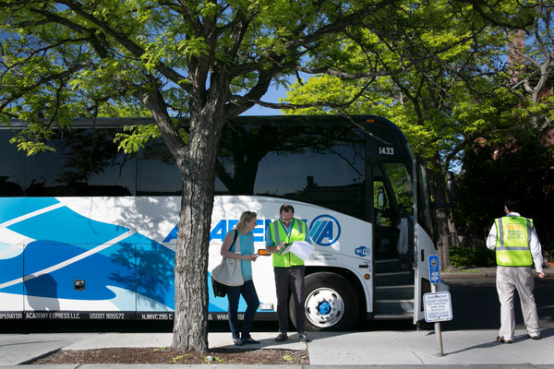
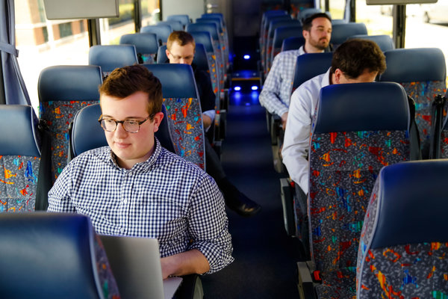
To Lure Bostonians, New ‘Pop-Up’ Bus Service Learns Riders’ Rhythms
http://static01.nyt.com/images/2014/06/03/multimedia/boston-bus/boston-bus-videoSixteenByNine540.jpg

Slide 3
BROOKLINE, Mass. — Katie Pasciucco, 34, an account manager at a software company, is a typical Boston commuter. Her door-to-door trip to work is just 4.5 miles but takes at least 50 maddening minutes.
With no predictable subway schedule available, she usually waits several minutes for a train. It makes numerous stops before she gets off, and then she still has to walk 20 minutes.
And so she leapt at the chance this week to travel a new way — by old-fashioned bus.
This new-old method of transport has comfortable seats and Wi-Fi. But its real innovation is in its routing. It is a “pop up” bus service, with routes dictated by millions of bits of data that show where people are and where they need to go. The private service uses chartered buses and is run by a start-up technology company called Bridj.
Bridj enters the Boston market at a tumultuous time for transit services here, where a proliferation of options has intensified the competition for rider dollars. (Boston has the third-highest share of households without cars in the country, after New York and Washington.) Ride-sharing services like Uber, which allow customers to hail cars — and now, even water taxis — on their smartphones, have disrupted Boston’s traditional taxi industry, which says that Uber has taken away 30 percent of its business.

Slide 4
Also in the mix is the Massachusetts Bay Transportation Authority, which operates the region’s bus and subway system, known as the T. It has just started late-night T service on weekends to meet the growing demand of Boston’s large college crowd, odd-hour technology workers and late-night service workers in bars and restaurants.
“It’s like the Wild, Wild West right now,” said Donna Blythe-Shaw, a spokeswoman for the Boston Taxi Drivers Association. “The T, taxis, Uber, Lyft — have smart app, will travel.” She predicted that Bridj would have “some impact,” but said it was too soon to say how much.
The transportation authority sees Bridj at this fledgling stage as a complement to the T. “This is not a competitive situation at all,” said Joseph Pesaturo, the authority spokesman.
Yet he was quick to note that the city bus fare of $1.50 and subway fare of $2 are much less than Bridj’s $6. And the city buses now have real-time smartphone apps that alert riders to arrival times.
But most of those who lined up on Monday for Bridj’s first day of beta service, which was free, said that problems with the T had prompted them to try Bridj.
“I’m tired of getting crammed in like a sardine on the train,” said J. P. Nahmias, a co-worker of Ms. Pasciucco’s.
Eva Zhou, a biotech worker, said, “There’s never an easy ride on the T, and it’s always crowded.” As for Bridj’s higher fare, she thought the service might qualify for her company’s stipend for employees who use alternative transportation.
On Bridj’s two maiden trips Monday morning, from Brookline to Boston’s financial district and to Kendall Square in Cambridge, the nonstop buses arrived more quickly than the subway.
For Ms. Pasciucco, Bridj shaved 10 minutes off her door-to-door commute. But what she appreciated most was the predictable schedule, allowing her to waste less time and arrive feeling less frazzled.

Slide 5
The brainchild of Matthew George, a 23-year-old entrepreneur, Bridj uses algorithms to make the bus routes “smarter.” As more people use it, it will adjust the routes accordingly.
Bridj collects millions of bits of data about people’s commutes from Google Earth, Facebook, Foursquare, Twitter, LinkedIn, the census, municipal records and other sources.
“We crunch these millions and millions of data points through a number of algorithms that are existing, or that we’re refining, to tell us where people are living and working,” Mr. George said. “And through our special sauce, we’re able to determine how a city moves.”
The system will become so smart, he said, that eventually it will take more people closer to their destinations. He will then swap out the 54-seat motor coaches he now leases for more efficient, smaller vehicles as Bridj expands its routes. Someday, he said, those vans could use automated vehicle technology — becoming driverless vehicles that avoid collisions, get better fuel economy and speed up traffic flow. And this, he said, will help reduce traffic congestion and greenhouse gas emissions.
Although similar technology-driven systems are being tested elsewhere, Bridj claims to be able to apply its data faster to create new routes more quickly.

Slide 6
Mr. George, while a student at Middlebury College in Vermont, was part of a team that built what he says is the nation’s largest network of pop-up bus services for college students going home on break. Called BreakShuttle, it has generated about $1 million a year in revenue by serving 15 colleges; it is scheduled to serve about 40 this fall.
His track record with BreakShuttle helped win investors for Bridj. His primary financial backer is Jill Preotle of Boston, an early investor in Zipcar, who said she was drawn to Bridj for its potential, like that of Zipcar, to reduce car ownership and therefore reduce traffic and pollution.
Mr. George is in talks to start Bridj in several other cities, which he declined to identify, by the end of summer. He is also preparing a plan to serve office parks on Route 128, the famous “technology highway” northwest of Boston, where thousands of commuters clog the roads in a bumper-to-bumper standstill.
Glen Weisbrod, president of the Economic Development Research Group, a consulting firm in Boston that recently completed a study of traffic congestion in high-growth business clusters like Kendall Square and Route 128, applauded Mr. George for using technology and creativity to address transit issues.
But while Bridj can help incrementally, Mr. Weisbrod said, it cannot solve the fundamental transportation problems of big cities. “Buses can only do so much,” he said. “They don’t eliminate the need for public investment in large-scale transit systems.”

Slide 7
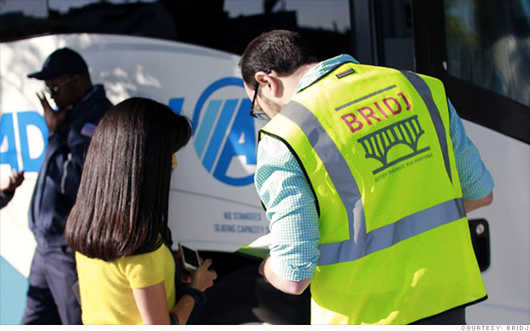
New bus companies aim to hack your commute By Ben Brody @CNNMoney June 17, 2014: 3:39 PM ET
http://money.cnn.com/2014/06/17/news/luxury-buses/

Slide 8
New bus services are using data from user's smartphones to predict where riders are, and where they want to go. They aim to get commuters to their destinations faster, and more comfortably, than public transportation can for just a few dollars more.
Boston's Bridj bus service and and Chicago's BlackLine service both launched this spring. The start-ups say they're combining data from public transportation systems, users' smartphones and GPS devices on board their buses to determine where to add or cancel routes on a day-to-day basis, and even to avoid traffic snarls.
The buses also offer reserved seats, WiFi and express service. A ride that costs about $2.50 on Boston's T transit system costs about $5 via Bridj. Bridj is in "beta" now, so tickets are free, but it says that so far "thousands" of users have signed up for the service.
"We're essentially reinventing your commute," said Ryan Kelly, marketing manager at Bridj.
But Bridj's success will depend on whether its service becomes popular enough to get a critical mass of commuter data.
Sarah Baston, who has used Bridj since it began operating at the beginning of June, says the company's routes are already a big improvement on her old commute from Brookline, Mass. to her job in Cambridge.

Slide 9
It used to take Baston 50 minutes to get to work via train and then a bus. Now she can get into the office in 20 minutes.
"It was a need in the city," she says. "It's unbelievable how much better my commute is.”A similar demand-driven bus service called Leap Transit is coming to San Francisco soon.
Still it's doubtful these upstarts will put public transportation out of business any time soon.Baston says her daily bus is only half full. Boston's public transportation authority, meanwhile, serves 1.3 million people each day.
And while both companies say they've secured the proper licenses and insurance, some cities may resist opening up public transportation to competition from private business.
As Uber knows, struggling with local regulations can mean a bumpy ride for a new transportation service.
Still, Kelly of Bridj says the company has big ambitions to carve out a market position between cramped-but-cheap public buses and more expensive and comfortable rides from taxis and Uber."Within a year we want to be national," Kelly said, "but we'll be in another city very soon."

Slide 10
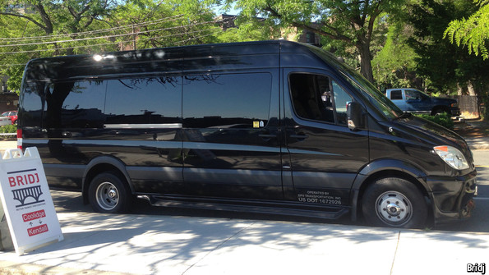
Carpooling uber alles Aug 20th 2014, 18:33 BY E.W. | WASHINGTON, DC
http://www.economist.com/blogs/schumpeter/2014/08/sharing-lift

Slide 11
“MARK my word,” Henry Ford declared in 1940, “A combination of airplane and motorcar is coming. You may smile, but it will come.” No doubt flying cars will eventually make their fashionably late arrival on the scene. But for the more immediate future of transportation, best is to take a look at a less futuristic and, ahem, more down-to-earth trend: carpooling.
This month Uber, Lyft, and Sidecar all launched carpooling services in San Francisco. Users can opt to share a ride with a stranger travelling along the same route at the same time for about half the price of a solo journey. Uber is in raptures at the disruptive ingenuity of its new service called UberPool: “The implications are profound… This is a bold social experiment… a brave new world.”

Slide 12
Yet a more interesting variation of the concept (which has been around for quite some time on the old continent in the form of sites such as BlaBlaCar and Mitfahrzentrale.de) is the service offered by Bridj, a startup based in Boston. It crunches data from many sources, including Google Earth, Facebook, the census and municipal records, to see where people live and work. The results are used to create routes that respond to commuters’ needs, rather than force them to conform to existing routes, many of which no longer match the flow of traffic. As more people use Bridj, plugging in their points of origin and destination, the “smarter” the system becomes, supplying customised, pop-up routes where people need them. The firm’s data scientists can even anticipate popular routes—for instance, in advance of a major concert or sporting event.

Slide 13
Average Americans in an average American city, explains Matthew George, founder of Bridj, currently have access to only 30% of jobs in their metropolitan area via 90 minutes of public transportation. The promise of Bridj, which works with local bus operators, is to save commuters time with more reliable service, no transfers and fewer stops than public buses or subway trains. A two-mile ride from Coolidge Corner to Kendall Square on Boston’s “T” train takes about an hour; Bridj’s direct shuttle (pictured) makes the same trip in 20 minutes. For many commuters, the convenience is worth the marginal price increase: at $6 per ride, Bridj is less than a taxi but more than a ride on Boston’s subway ($2.50) or the city bus ($1.50).

Slide 14
Creating better routes to high-density destinations doesn’t sound terribly revolutionary, and carpooling might not be the sexy mode of travel envisaged for the 21st century. But the economic and environmental consequences of this shift could be important. Carpooling services could disrupt public-transport systems in much the same way that Uber and Lyft are disrupting the taxi industry.
Bridj, for instance, promises to be economically inclusive, but it is more likely to service consultants and comfortable tech employees than Boston’s minimum-wage commuters. And by taking customers away from subways and buses, it threatens to drain public transit systems of much-needed funding, which could drive up costs for those who rely on public services. Getting some people to their jobs faster may come at the cost of depleting access for others. Every disruption has its losers and winners. That will certainly also be the case when flying cars finally land.

