Slide 1
Ｕｂｅｒがなげかけたもの （作成中）

Slide 2
Maaxi
Its backing is in large part down to the fact that Maaxi promotes itself as a black cab-only facility, unlike rival apps that also offer private hire cars.
"The taxi driver charges each person less than the meter fare but overall gets more, when aggregating all the partial fares - a true win-win," explained Gabi Campos, the firm's chief executive.

Slide 3
Maaxi app aims to help black cabs counter rise of Uber
www.maaxitaxi.com
https://www.youtube.com/watch?v=AAcmg11K6Fw&feature=player_detailpage
advert for Maaxi notably

Slide 4
乗合と貸切の融合 停車場・時刻表方式の終焉
Maaxi is designed to match up to five strangers travelling in the same direction, so that they can share a ride and split the bill.

Slide 5
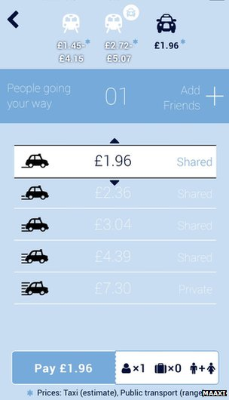
Prices are determined by how many people the passenger shares with, affecting their journey time

Slide 6
The system integrates with Transport for London and National Rail's timetables to allow travellers to co-ordinate the "last mile" of their journeys.
In addition, it can arrange passenger pick-ups to be "daisy-chained", so that drivers can continue picking up and dropping passengers as they go, rather than transporting one group at a time.

Slide 7
Uber began its own shared-trips service, UberPool, last month. But the facility is only available in San Francisco.
The Google-backed company has been the target of black cabbies' ire in recent months.

Slide 8
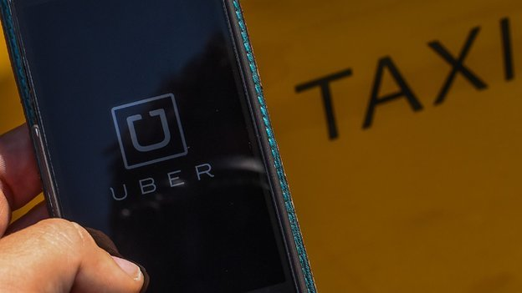
Judge overturns Uber ride-sharing ban in Germany
A German judge has overturned a nationwide ban on one of the services offered by the alternative taxi firm Uber.

Slide 9
The temporary injunction banned the start-up from offering its UberPop ride-sharing service in the country.
Frankfurt Regional Court Judge Frowin Kurth ruled that taxi companies in the country had waited too long to request an emergency injunction.
The German Taxi Association, Taxi Deutschland, said that it would appeal.
"The taxi industry accepts competitors who comply with the law. Uber does not," it said in a statement.

Slide 10
For its part Uber welcomed the judge's decision.
"UberPOP is revolutionising transport in cities and beyond by helping to create smarter cities with more transport choices," the firm said.
"Demand is so great all across the country that we expect to double in size by the end of the year and plan to bring Uber to more and more cities across Germany."
Although the temporary injunction against Uber has been lifted, the case goes on as part of an ongoing civil lawsuit brought by Taxi Deutschland.

Slide 11
London protests
There has been mounting opposition to services such as Uber which uses smartphone apps to connect drivers and customers.
UberPop is one of several services offered by the firm and has proved particularly controversial because it uses drivers not directly employed by the company and therefore without professional transportation licenses.
In London, cab drivers launched a day of protests over Uber's services which they claimed broke Transport for London rules.
Similar protests have been held in Paris, Madrid, Rome, Milan and Berlin and the service has also been banned in Seoul.
Uber operates in more than 205 cities across 45 countries.

Slide 12
8 September 2014 Uber hires lobbyist after German ban
The car pick-up firm Uber has strengthened its lobbying team after its service was banned in Germany.
The firm confirmed it has hired Mark MacGann as head of public policy for Europe, the Middle East and Africa.
A Frankfurt court recently ruled that it was not operating its "low cost" UberPop service legally. Uber has also been the subject of protests across European cities, including London.
But Uber vowed to continue operating and fight the German ruling.
Mr MacGann, who has previously held senior jobs with the lobbying firms Weber Shandwick, Brunswick and FIPRA, would be tasked with pushing through Uber's planned European expansion, the company confirmed.

Slide 13
Battle
According to his own LinkedIn profile, Mr MacGann has specialised in "challenging incumbents to gain market access for innovative and disruptive industrial ventures".
The firm has faced stiff opposition from cab drivers across the continent, who have complained that it competes unfairly.
The firm, which is backed by Google and Goldman Sachs, often offers a lower cost service than local cabs do but has been accused of sidestepping much of the regulation involved.

Slide 14
Barcelona cab drivers strike in protest at Uber in July this year

Slide 15
It says it simply connects drivers with passengers and calculates the fare based on GPS. But cab drivers say it is a meter by any other name, which they need to be licensed to use.
In June this year, protests took place in many European cities, including Berlin, Paris and London. And, in August, a French court demanded that Uber change how its driver invoice system worked, to meet local rules.
That was followed by actions in the German courts, the most recent battle taking place in Frankfurt.
There, the judge issued a summary judgment, placing a ban on Uber pending a full hearing. The firm could face up to a 250,000 euro ($327,840; £198,342) fine per trip if it ignores the restriction - as it has said it intends to do.

Slide 16
Expansion
Uber has stated its desire for rapid expansion in Germany. Only days before the German ban was ordered, it said it expected to double its size in the country by the end of the year.
Despite protests in London, the British authorities have provided lesser opposition, deciding not to pursue a case against Uber in June.
Uber is not alone in employing lobbyists to present its interests on a multinational level. However, the appointment of a lobbyist of more than two decades' experience indicates how seriously it is taking the challenges it currently faces in Europe.
The firm said it would release a more substantial statement on the appointment later on Monday.

Slide 17
1 August 2014 Uber app 'competing unfairly', Margaret Hodge claims
The Uber taxi app is "competing unfairly" with London's black cabs, senior Labour MP Margaret Hodge says.
She has written to Boris Johnson asking why Transport for London allows cars to take bookings through the app without a licence to operate in the capital.
Mrs Hodge claims the firm is "opting out of the UK tax regime" but Uber said it complied with "all applicable tax laws".
Thousands of taxi drivers protested against the app in June.
The smartphone app works out the cost of fares using GPS. Cab drivers say it is similar to using a taxi meter, which only they are legally entitled to do.

Slide 18
'Impact on livelihoods' The app's Dutch operating company, Uber BV, does not pay tax in the UK - but Mrs Hodge said TfL could insist that it does so.
She said: "I am particularly concerned about the tax structure that Uber and others have apparently constructed and the impact this has both on the public purse and on the livelihoods of London cabbies and private hire drivers.
"This structure allows these new entrants to unfairly undercut London operators by opting out of the UK tax regime.
"TfL allows this to happen by failing to apply the appropriate regulations to Uber."

Slide 19
In the letter to Mr Johnson, the mayor of London, Mrs Hodge, who chairs the cross-party Commons Public Accounts Committee, added: "Surely TfL has a duty to enforce legislation that will ensure a fair and level playing field for all taxi and private hire operators?
"I would be grateful if you could set out the steps you will take to ensure that TfL does not inadvertently allow tax avoidance in London and that all taxi and private hire drivers receive a fair deal."
She has been backed by the Licensed Private Hire Car Association (LPHCA), which represents 20,000 cabbies.

Slide 20
'Corporate greed'
LPHCA chairman Steve Wright said: "London's taxi and private hire industries are being compromised by inconsistent licensing enforcement by TfL and the apparent ability for app-based operators like Uber to operate through an offshore tax regime.
"As well as the loss in revenue to the country, a whole industry that has a wonderful compliance record - unlike some of these new apps - is being undermined by foreign entities, working the UK tax system for corporate greed."

Slide 21
But an Uber spokesman said: "Uber complies with all applicable tax laws, and pays taxes in all jurisdictions, such as corporate income tax, payroll tax, sales and use tax, and VAT.
"Uber London Limited is a licensed private hire vehicle operator and recently passed the largest inspection of records ever conducted by TfL."
Chief operating officer at TfL Garrett Emmerson said he was "fully satisfied" the app was operating lawfully.
He added: "TfL's role is to licence and regulate the taxi and private hire industry in London. We do not have any powers in relation to an operator's corporate structure and how or where they pay tax."

Slide 22
5 February 2013 Hailo - cabbies and capitalists
It's hard to think of many UK tech firms that have gone global in recent years - but a business started by three entrepreneurs and three London cab drivers may well be the cream of the crop.
Hailo, a mobile phone app which allows you to virtually hail a cab, has unveiled a major new investment and plans to launch in New York and Tokyo.
The app was launched in London in November 2011. Its success was by no means guaranteed, as at least half a dozen similar ideas were already on offer to the capital's taxi and minicab users.
I've been chatting to Hailo's chairman, American entrepreneur Ron Zeghibe, and to Russell Hall, one of the three cabbies involved from the start, about what really made a difference.

Slide 23
Ron, who's spent 20 years outside the US launching various businesses, explains that he and two other entrepreneurs had come up with an idea for a taxi app. But they realised that the key to success would be an intimate knowledge of the cab trade, and that's when they met up with Russell Hall and his two colleagues.
The cabbies had already been operating their own web-based service, Taxilight, for a couple of years but wanted to move it on to a new level. The two groups clicked.
"We sat in a cafe in Charlotte Street," says Russell, "and chatted for hours on end about the moans and groans of cabbies and customers, and after endless cups of teas and rounds of toast we shook hands on a new concept."

Slide 24
The key appears to have been making the Hailo app work first as a useful tool for cabbies, even before it was launched to consumers. Ron says what they came up with was "a working tool for drivers, with a whole series of aspects which made their working day more useful and effective".
This meant that when they did launch to customers, they already had hundreds of drivers signed up - so when you clicked to request a taxi there was a fair chance of getting one.

Slide 25
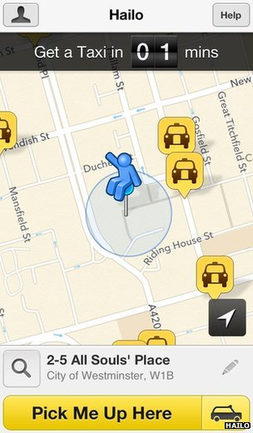

Slide 26
Today, more than 10,000 London cabbies are using the app - that's probably at least half of those who are actually out on any one day.
In my experience, the app works pretty well for the customer, although the cabbies I've spoken to, have given it mixed reviews. Some swear by it. Others say they resent having to hand over commission to Hailo, but feel they have to be part of a system which has quickly become almost compulsory.

Slide 27
That in a way is a measure of its success, and Hailo is hoping to reproduce that network effect in New York and Tokyo.
The founders admit that New York, in particular, is a very different taxi market. Far from doing the knowledge, it sometimes seems that cabbies rely on passengers to navigate them across the city. And instead of asking drivers to pay commission, users will incur a small fee every time they book a cab.
But having already launched successfully in Chicago and Boston, the Hailo team is confident its recipe will work anywhere.

Slide 28
I ask Russell Hall whether he has been taken aback by his progress from cabbie to part of a global business. He says he's not: "I've always believed it's what's been missing in any taxi market in any city in the world. What we've created in London will go to any city."
That kind of global ambition is what marks Hailo out from many other UK technology start-ups.
What also makes it different is the willingness of the venture capital community here and in the US to back it. The latest $30m investment round includes Union Square Ventures, which backed Twitter, along with original European backers Accel Partners and Atomico Ventures.

Slide 29
Ron Zeghibe, who has spent two decades trying to get businesses off the ground, says he has seen a real evolution in venture capital in Britain. "It is so different from 20 years ago. Today you truly have real money chasing good ideas."
So cabbies and capitalists have come together to build a global business from nothing, inside two years.
Maybe London's ambitions to be a rival to Silicon Valley aren't so bonkers after all - although as far as I can see, the Hailo team have got this far without straying anywhere near trendy Shoreditch.

