Slide 1
VIA プレゼン資料（英文）
２０１８．１．２４

Slide 2
LAND Transportation Reguration System
IN JAPAN
Shuichi Teramae PhD
President OF Human Logistics ＆ Tourism Laboratry

Slide 3


Big Differences in thinking on public transport
ＰＵＢＬＩＣ ＰＲＩＶＡＴＥ
RAILWAY
PUBLIC ＢＵＳ
（as common carrier）
Street-hiring vehcle＆non-ride-sharing（DRIVER＆ at most ９Passenger）
Non-street-hiring&non-ride-sharing Vehcle（DRIVER＆at most ９Passenger）
ＰＲＩＶＡＴＥ CAR
（including DRIVER-DISPATCH,
CAR-RENTAL）
Non-Street-hiring ＆non-ride-sharing Vehcle①（DRIVER＆at least 10 Passenger）
Permission strictly difficult
Tax preferential treatment for commuting expenses
Non-street-hiring Vehcle②
Ride-Sharing with permission
private use(Non-Paid including actual expense claim）
PUBLIC（Paid transport）

Slide 4
Omnibus
Sheduled
ON-DEMAND Vehcle
It is not supposed by the Road Transport Law
Street-hiring Vehcle
,BUT・・・
Fixed Route

Slide 5
Mysterious Travel Bussiness Act System
On-Demand-Service by Vehcle is not supposed by Transport Act, but could be delivered by Travel business Act.
The Reason is easily understood through the next figure.

Slide 8
Transport administration in Japan
Unlike Western countries, The supervision of land transportation projects such as taxis and buses is the authority of the central government.
The transportation system operated by the municipality receives the same treatment as the private shipping company.
Municipalities are responsible for road management administration and traffic police administration, and state agencies are in charge of transportation business regulations.
The historical reason why state institutions are in charge of regulations on transportation business depends on the fact that the railway was state-run long ago. However, the National Railways is now privatized.

Slide 9
Metropolitan Passenger Traffic (in Tokyo)
The principal railroads in central Tokyo are operated by such as JR East and Tokyo Metro Company (the state and the Tokyo Metropolitan Government contribute 50% each) and the Tokyo Metropolitan Government.
Regarding public buses, in the Tokyo metropolitan area these are managed by Tokyo Metropolitan Government and in the suburbs are operated by private companies.
As for the taxi business, private companies and individuals operate and are supervised by state agencies. Also there are no difference legally between street-hailing and non-street-hailing. These two points are differences between Tokyo and New York / London.

Slide 10
Metropolitan BUS Transport (in Tokyo)
Route with possibility of ride sharing
JR Ｃｉｒｃｌｅ LINE
Route with possibility of ride sharing
Tokyo-Metropolitan-Government-operated-Bus area
Shinjuku Station
Late night, early morning
Small community bus operated
City authority
Small community bus operated
City authority
Small community bus operated
City authority
Small community bus operated
City authority
Central Station
Small community bus operated
City authority
Private Transportation Bus Company area

Slide 11
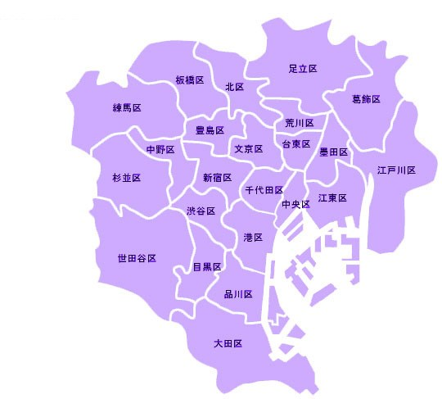
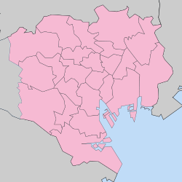
⑥
⑩
②
③
⑤
１．港区 903.7万円
２．千代田区 762.9万円
３．渋谷区 683.6万円
４．兵庫県芦屋市 567.1万円
５．中央区 546.8万円
６．文京区 545.6万円
７．目黒区 526.7万円
８．世田谷区 502.5万円
９．武蔵野市 479.5万円
10．新宿区 475.3万円
⑧
①
⑦
HANEDA airport

Slide 12
Ridesharing by real Taxi-sevice
From 22th Jan. to 11th Mar. Government-led demonstration experiment using 949cabs is going to start in TOKYO Grater Zone.
Not-flat-rate, Special application
Example of failure MAAXI
CONVERSION TABLE FOR USE IN CALCULATING SHARED FARES In London

Slide 13
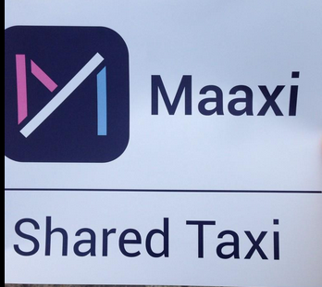
https://maaxitaxi.com/
NOTICE: This domain name expired on 1/16/2018 and is pending renewal or deletion.

Slide 14
User recruitment
Partnership with a real estate company
Posting A mailbox

Slide 15
Driver＆Cab recruitment
Minimum guarantee

Slide 16
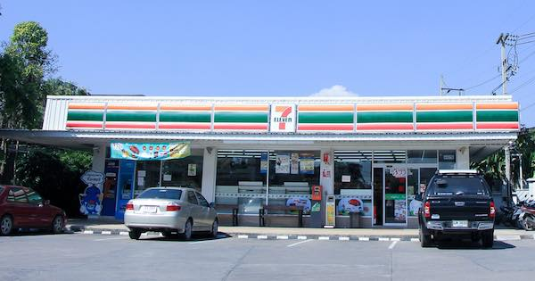
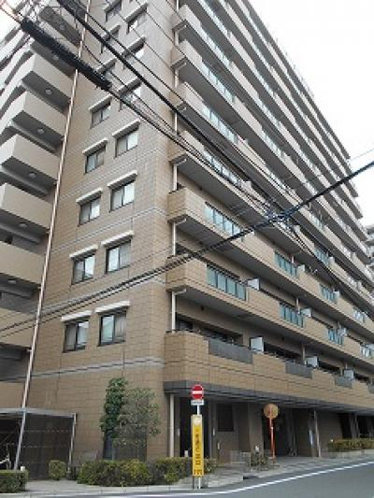
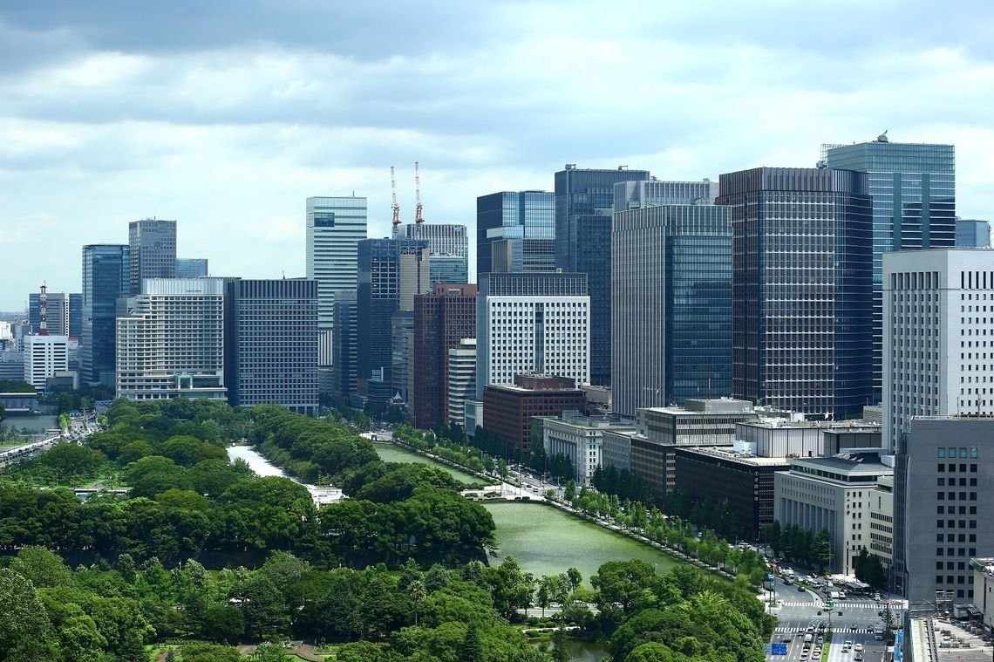
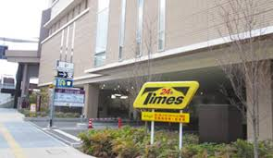
Stage 1 before ２０２０-TOKYO-OLYMPIC

Slide 17
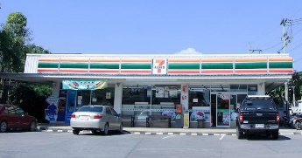

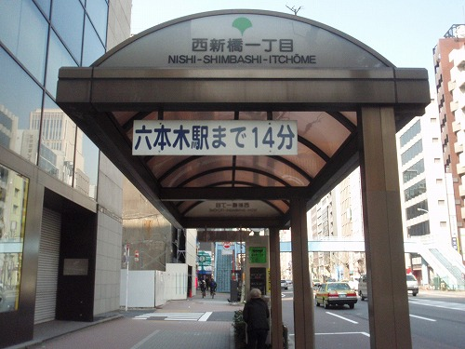

Stage ３
Other BIG CITY（Osaka,Nagoya,Yokoham）
+
Bus stop
withWIFI Spot

Slide 18

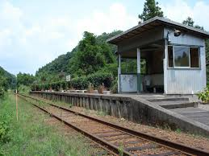
Stage ４
Ｒural area

Slide 19
Stage ４
Precondition
Municipal real management（Economic subsidy）
Operating costs are actual expenses
Emphasize sociality
Expect for propaganda effect

Slide 20
Urban and rural transport issues
In Japan, paid transport by private car is prohibited. Therefore ride-sharing has become a social problem. There are not many inconvenience for users because there are many taxi supplies in big cities in Japan.
The occurrence of a traffic accident of the elderly and the return of the driving license of the elderly become a social problem.

Slide 21
JERON TAXI
AS Malti-Package-Tour
Elderly driver problem
Monthly Fixed Rate
Hospital
convenience store
Railway station
Home
Emergence of new terms and conditions
Handling of compensation during home
Itinerary guarantee responsibility
All you can use
Special compensation responsibility

Slide 22
Reference material

Slide 23
Mystery of package tour fare system
The combination meal of McDonald is cheap rather than placing an order for the same thing individually. The price of package tour is also the same. However, the regal system of railroad, automobile, aviation and shipping have regulations about fares. The accommodation fare of registered international tourist hotels is based on the pre-notification system. Therefore, prices cannot be decided freely if the price of package tour doesn’t receive the application of regulatory systems. However, various products are sold practically. Besides explanation is impossible and becomes near, if there will be all the applications of the foreign fare rate regulation about the overseas package tour. Interest leans on the institutional explanation of this.
Travel agency decides prices of package tour by himself as his own services. Irrespective of the regulation fare about movement or stay, it sells at all inclusive price (pack price) by his calculation. Since products of the self are sold, naturally the contract responsibility for consumers occurs. The person bearing this contract responsibility is travel agency. It is not the agent of transport organization and the staying organization.

Slide 24
Supposing the contractual liability of travel agency was lower than the liability of transportation business and lodging industry, it began to be recognized to be a problem. Each transportation business law and the Act on Development of Hotels for Inbound Tourists are the laws which control the relation of B2C (Business to Consumer) aiming at user protection. The relation of B-2B (Business to Business) is not assumed directly.
In case of package tour, there are three relations, the relation between real user and real shipping agency, the relation between travel agency and real shipping agency, and the relation between real user and travel agency.
Pains will be taken over the rational explanation as the whole if regulation of the transporting method starts these three relations simultaneously. For this reason, in railroad administration, it was presupposed that there is no application of regulation in B2B.

Slide 25
Single article package tour
～mysterious merchandise uniquely in Japan～
A package tour has nuance called the combination of two or more things as the name suggests. However, a single article type package tour developed actually. The appearance of these products including a single article type package tour promoted price competition, and had big influence on the structural reform of passengers transport enterprise.
In EC, when specifying a package tour, it is specified that it contains two or more [such as transportation and stay] at least, and what is called a single article type is eliminated.

Slide 26
Travel agencies purchase many guest rooms for package tour products creation beforehand. However, travel agencies sold guest rooms alone because guest rooms did not remain unsold when travel agencies purchased guest rooms even more. This is the beginning of single article package tour.
The inclusive tour discount excursion fare currently based on regulation of the Aviation Act is carried out on condition of "two or more combination", 24 hours and an "overnight-stay" rule. This is because the airfare is created in accordance with the international rule.
About single article package tour, there is also voice which a difference with an arrangement travel is hardly known, and its social significance is called into question. Single article package tours promoted competition in the world of real transportation, and they developed structural reform of human logistics. In addition, in Taiwan, single article package tours are admitted.

Slide 27
Monthly riding free fixed amount fare
Transport company "UBER" which Google financed struck Japan. There was not the spotlight as having been introduced to be "the landing calmly" in Japanese Magazine FACTA. Although this UBER does business as a tourist agency, it is judged that service is provided not as a package tour but as an arrangement travel.
There is still much distance, but in UBER I feels the thing which I expected in the book which I wrote as “Mobile-Transport Revolution”. Aside from expectation to UBER, I name the virtual fixed amount taxi as the package tour product “YUBI-TAXI” as follows and describe it as follows.

Slide 28
(Monthly riding free fixed fare amount taxi YUBI-TAXI)
If I call YUBI-TAXI from a smart phone in Tokyo, the car position map which specified the arrival times and the current position in which I am present will appear on a screen.
At the time of traffic congestion in rainy days, if refusing riding together, the display of the charge added to the already paid free-ride fare comes out. This simulated fixed system is not incorporated with the regulation fare of present taxi. Then, why is this system possible?
In fact, YUBI-TAXI is travel service. It is the same as the package tour service which JTB etc. sell. Package tour service is the service created in self calculation. The taxi services which constitute the product are parts. As for the prices of parts, it is nonrelated to users.
If you go to a convenience store at night, the stay coupon of reputable hotel in the metropolitan area is sold for $50 by machine. As the Act on Development of Hotels for Inbound Tourists, since many metropolitan area reputable hotels serve as a notification charge, they cannot change a charge dexterously. Therefore, this coupon is sold as package tour of travel agencies. It is just the same as YUBI-TAXI.

Slide 29
Next, is road transport laws system applied between YUBI-TAXI which is a travel agency, and a taxi company which is a real transporting agency or not? That is the problem. If it says from a conclusion, according to the governmental custom, it is not applied between them. The transport system of a bus and a taxi used the railway law system of Japan as the sample, and were made. A fearful law called the JNR Fare Law existed, because the JNR fare was presupposed like the tax that the concrete amount of money must be defined by law.
When the JNR Fare Law was applied between JNR and travel agencies, package tours are not made. Naturally it was understood that it isn’t applied between them. By thinking naturally, the system of a bus and a taxi which were located in the outskirts of the JNR system also was the same. Therefore, the regulation of the road transport law isn't applied between a taxi company and YUBI-TAXI.
This point differs from the Aviation Act system which institutionalized a special fare for package tours called package rates by IATA or administration. Furthermore, it is more complicated to understand the legal character of package tour price.
Although it is natural, an employment agreement is not between YUBI-TAXI and Taxi Driver. It is a taxi company that signs an employment agreement with Taxi Driver. The same may be said of labor conditions.
What kind of legal relations between YUBI-TAXI and real users is? It is said YUBI-TAXI will take the special compensation responsibility and the itinerary guarantee responsibility.

Slide 30
About the itinerary guarantee responsibility, it teaches us that a basic problem exists in Travel Agency Act. Although there was also an opinion to which it is insisted that the same contractual liability as a transporting agency should be taken. However, it would be hesitated until now at this stage when a travel agency could not control the real service of the overseas transportation company.
However, because YUBI-TAXI can grasp the service of the car every moment through smart phone system, it is reasonable that the transport guarantee responsibility is taken by YUBI-TAXI.
In the current Travel Agency Act, existence of "the use transport business of using real transport service" to take the transport responsibility is prescribed. If YUBI-TAXI takes form of the use real transport, it gets closer to human logistics.
Finally I suggest "monthly riding free fixed amount fare (monthly unlimited flat rate price)". If a real taxi business can adopt this fare as its transport system, there is no problem. However, it is actually difficult for introduction to obtain an understanding of government.
Although the Taxmobil concept was proposed in south Germany, there is a strong opposition from a labor union and it has not yet realized. Therefore, introducing as a package tour price is realistic.
One of the structures which do not show a cost price is a fixed amount use free system. The charge of the cell-phone is representative. The appearance of the smart-phone may greatly change business model of human logistics. The appearance of the package tour product which evolved is expected. You can use a bus, a taxi and service of other transportation by a monthly fixed rate without any restriction.
It may be necessary to create the new "human logistics" concept that is beyond the concept called the itinerary.

Slide 31




Building a database on human movement
Depends on the ability of the driver
Improvement of demand prediction accuracy by using database
Improvement of dispatch algorithm
Dilution of distinction between street-hiring and business waiting in the garage
Continuation of street-hiring
Black-Cab
OWNER DRIVER
Cab FREET
in Tokyo
Popularization of PHV
Us,uk Japan
Mini-Cab
Uber,Lyft
Shortage
IN NYC,LONDON
Excess
In Tokyo
Number of street-hiring cars
DEMAND
DEMAND
SUPLY
SUPLY

